Slide 1
Học máy trong phân tích kinh doanh
Bài Học
Microsoft Machine Learning Framework
Giảng viên:
TS. Trần Duy Thanh
Email: thanhtd@uel.edu.vn
Blog: https://tranduythanh.com

Slide 2
Mục tiêu bài học
Introduction ML.NET machine learning framework
Explorer the features and functions of ML.NET
Take a very simple sample with ML.NET Builder

Slide 3


Introduction ML.NET
ML.NET is a free, open-source, cross-platform machine learning framework made specifically for .NET developers.
With ML.NET, you can develop and integrate custom machine learning models into your .NET applications, without needing prior machine learning experience.
ML.NET is an extensible platform, with tooling in Visual Studio as well as a cross-platform CLI, that powers recognized Microsoft features like Windows Hello, Bing Ads, PowerPoint Design Ideas, and more.
Source: Microsoft
Build intelligent .NET apps with features like emotion and sentiment detection, vision and speech recognition, language understanding, knowledge, and search.

Slide 4
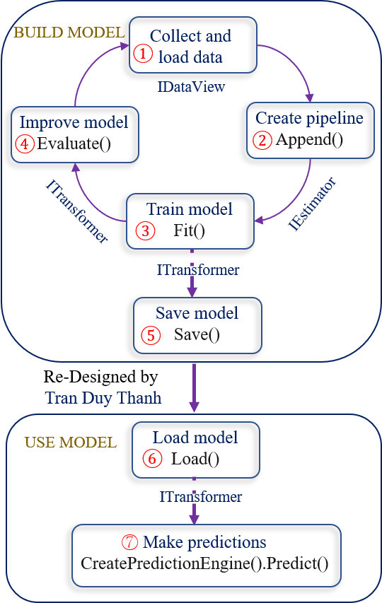
Introduction ML.NET
Code workflow
The following diagram represents the application code structure, as well as the iterative process of model development:
Collect and load training data into an IDataView object
Specify a pipeline of operations to extract features and apply a machine learning algorithm
Train a model by calling Fit() on the pipeline
Evaluate the model and iterate to improve
Save the model into binary format, for use in an application
Load the model back into an ITransformer object
Make predictions by calling CreatePredictionEngine.Predict()

Slide 5
Explorer the features and functions of ML.NET
Built for .NET developers
Custom ML made easy with AutoML
Extended with TensorFlow & more
High performance and accuracy
Trusted and proven at scale

Slide 6
Built for .NET developers
With ML.NET, you can create custom ML models using C# or F# without having to leave the .NET ecosystem.
ML.NET lets you re-use all the knowledge, skills, code, and libraries you already have as a .NET developer so that you can easily integrate machine learning into your web, mobile, desktop, games, and IoT apps.

Slide 7










Built for .NET developers
Sentiment analysis
Product
recommendation
Price prediction
Analyze the sentiment of customer reviews using a binary classification algorithm.
Recommend products based on purchase history using a matrix factorization algorithm.
Predict taxi fares based on parameters such as distance traveled using a regression algorithm.
Customer
segmentation
Fraud detection
Object detection
Identify groups of customers with similar profiles using a clustering algorithm.
Recognize objects in an image using an ONNX deep learning model.
Detect fraudulent credit card transactions using a binary classification algorithm.
Sales spike
detection
Sales forecasting
Image classification
Detect spikes and changes in product sales using an anomaly detection model.
Classify images using a TensorFlow deep learning model.
Forecast future sales for products using a regression algorithm.

Slide 8
Custom ML made easy with AutoML
ML.NET offers Model Builder (a simple UI tool) and ML.NET CLI to make it super easy to build custom ML Models.
These tools use Automated ML (AutoML), a cutting edge technology that automates the process of building best performing models for your Machine Learning scenario. All you have to do is load your data, and AutoML takes care of the rest of the model building process.

Slide 9
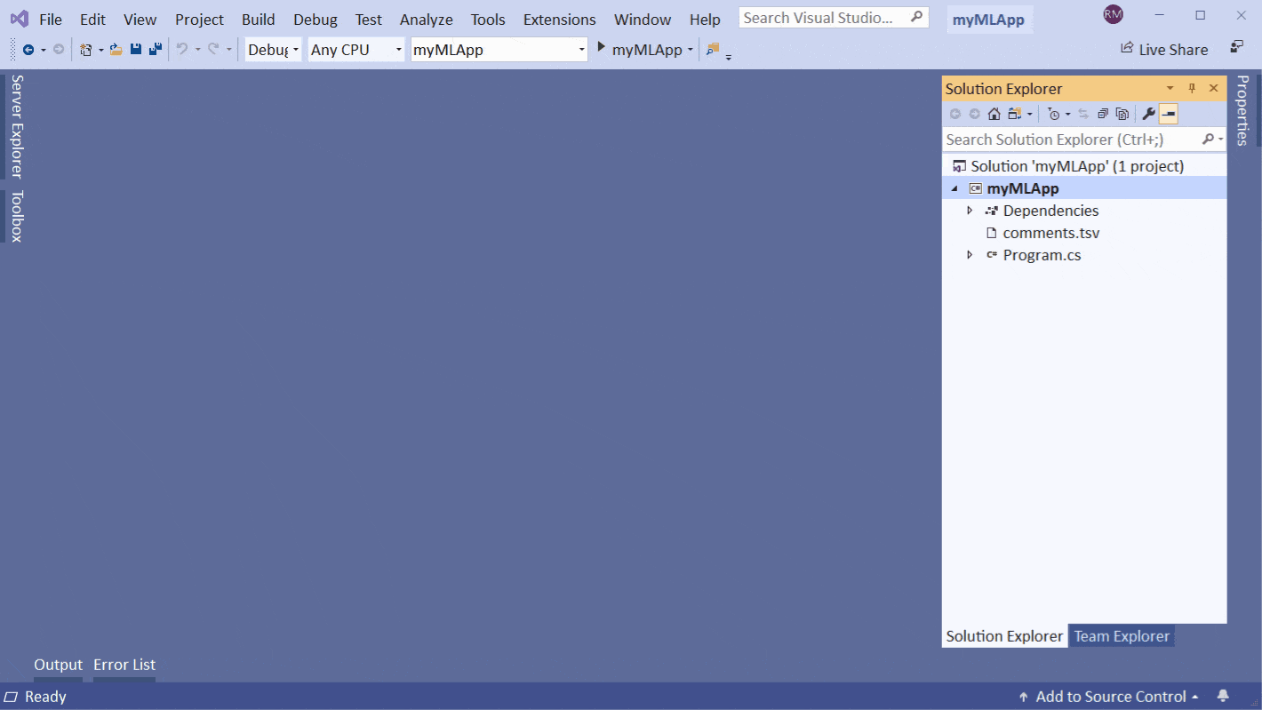
Custom ML made easy with AutoML

Slide 10
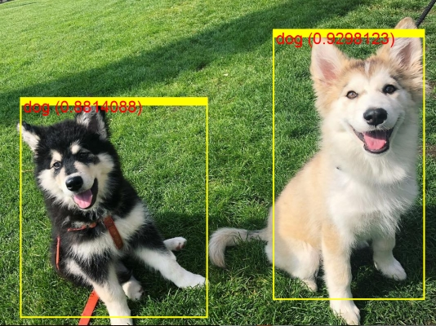
Extended with TensorFlow & more
ML.NET has been designed as an extensible platform so that you can consume other popular ML frameworks (TensorFlow, ONNX, Infer.NET, and more) and have access to even more machine learning scenarios, like image classification, object detection, and more.

Slide 11
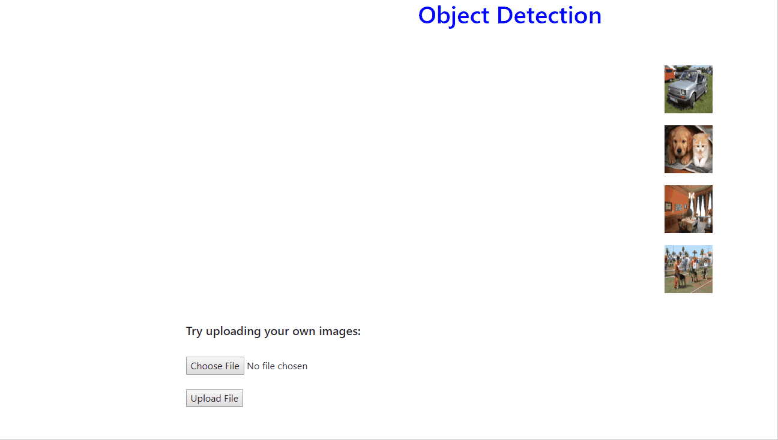
Extended with TensorFlow & more

Slide 12
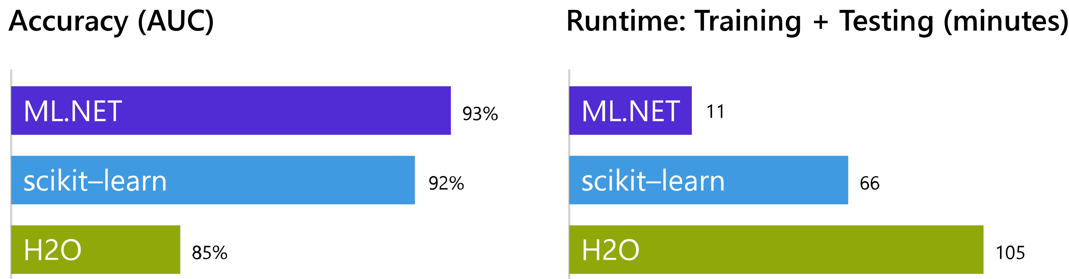
High performance and accuracy
Using a 9GB Amazon review data set, ML.NET trained a sentiment analysis model with 95% accuracy. Other popular machine learning frameworks failed to process the dataset due to memory errors. Training on 10% of the data set, to let all the frameworks complete training, ML.NET demonstrated the highest speed and accuracy.
The performance evaluation found similar results in other machine learning scenarios, including click-through rate prediction and flight delay prediction.

Slide 13
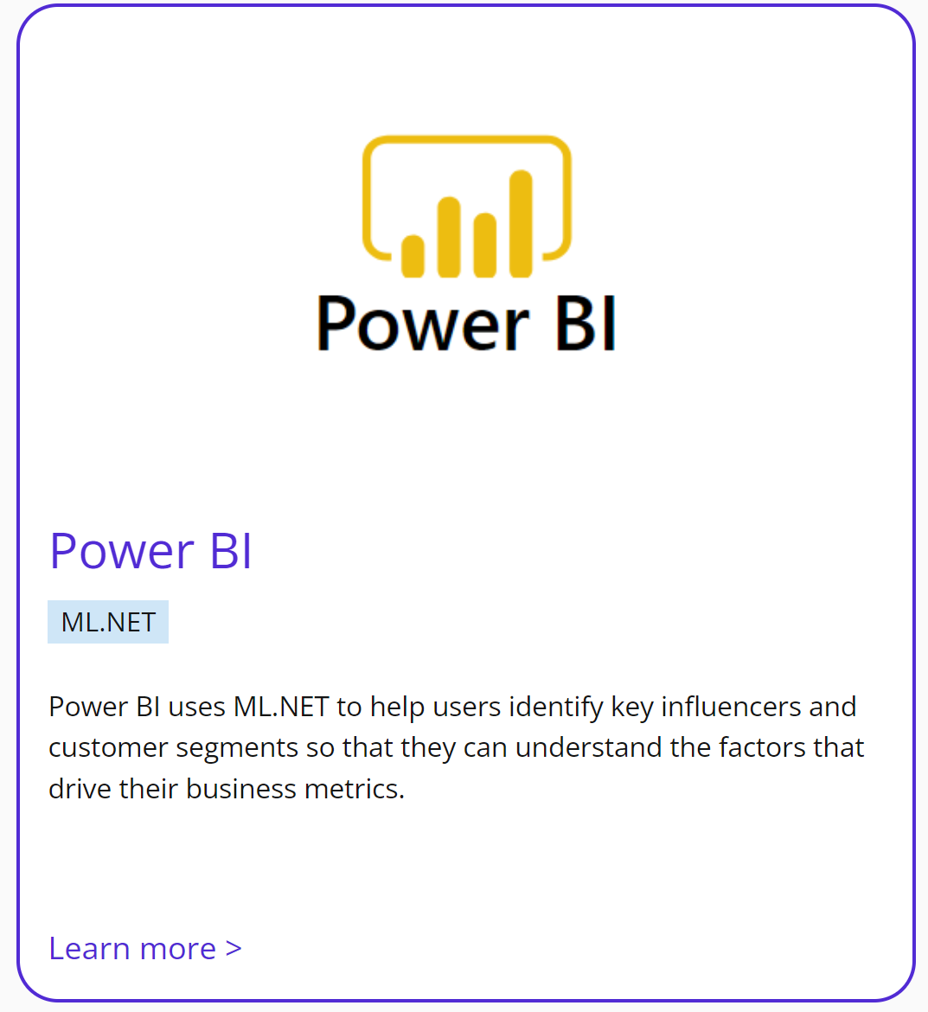


Trusted and proven at scale
Use the same ML framework used by recognized Microsoft products like Power BI, Microsoft Defender, Outlook, and Bing.

Slide 14
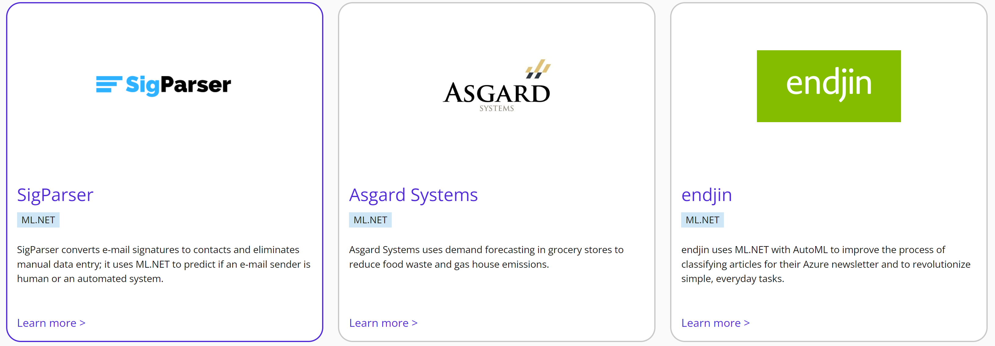
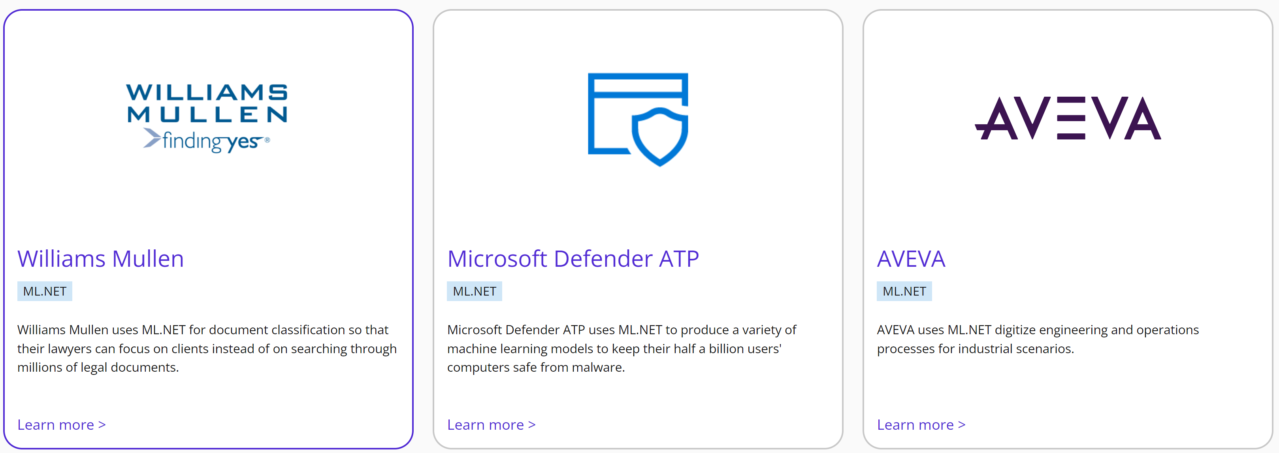
Trusted and proven at scale

Slide 15
Sample ML.NET Builder
Sentiment model sample
Download the Sentiment Labelled Sentences datasets from the UCI Machine Learning Repository. Unzip sentiment labelled sentences.zip and save the yelp_labelled.txt file to the myMLApp directory.
https://archive.ics.uci.edu/ml/machine-learning-databases/00331/sentiment%20labelled%20sentences.zip
Each row in yelp_labelled.txt represents a different review of a restaurant left by a user on Yelp. The first column represents the comment left by the user, and the second column represents the sentiment of the text (0 is negative, 1 is positive). The columns are separated by tabs, and the dataset has no header. The data looks like the following:

Slide 16
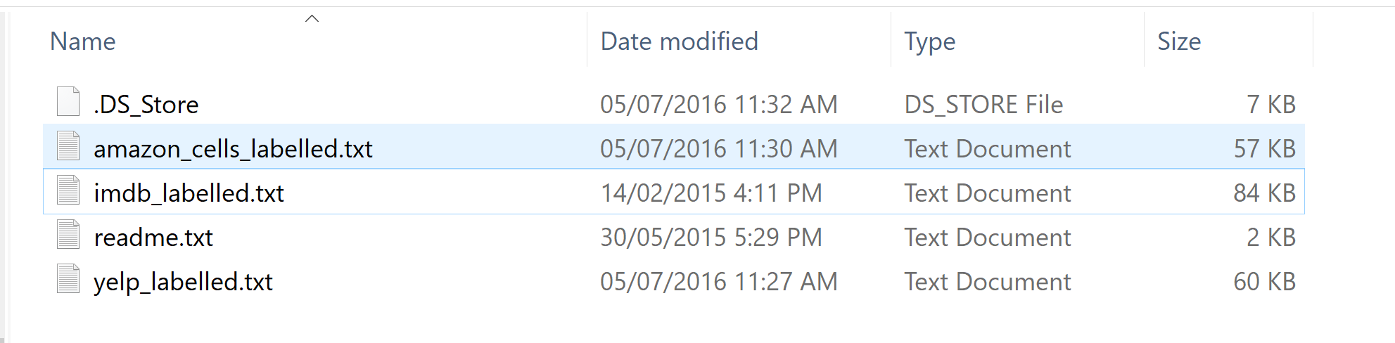
Sample ML.NET Builder
Sentiment model sample

Slide 17
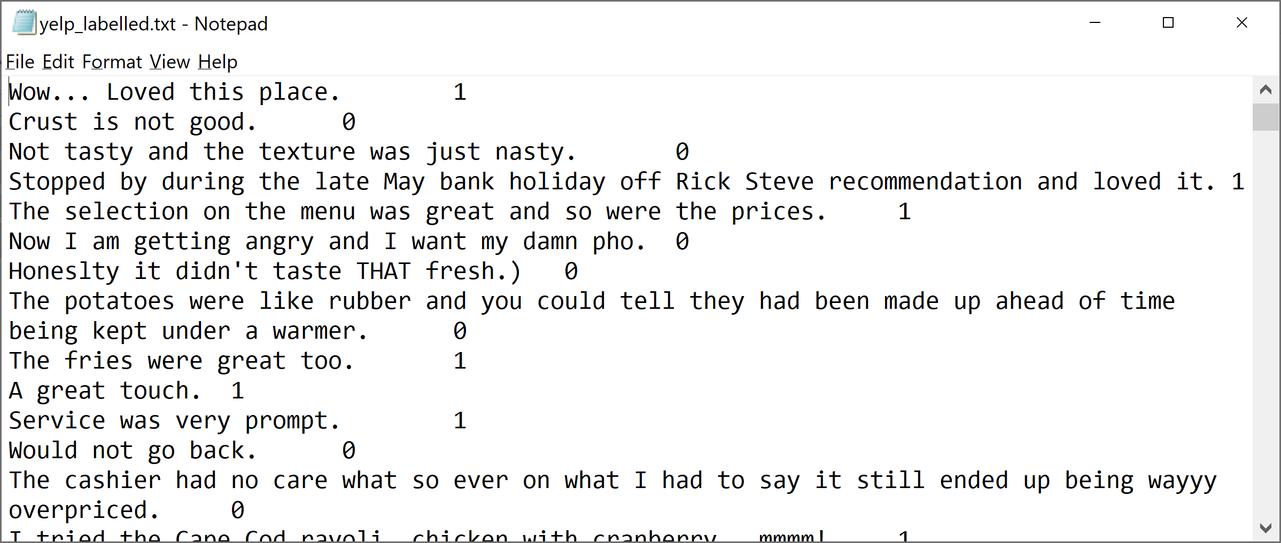
Sample ML.NET Builder
yelp_labelled.txt

Slide 18
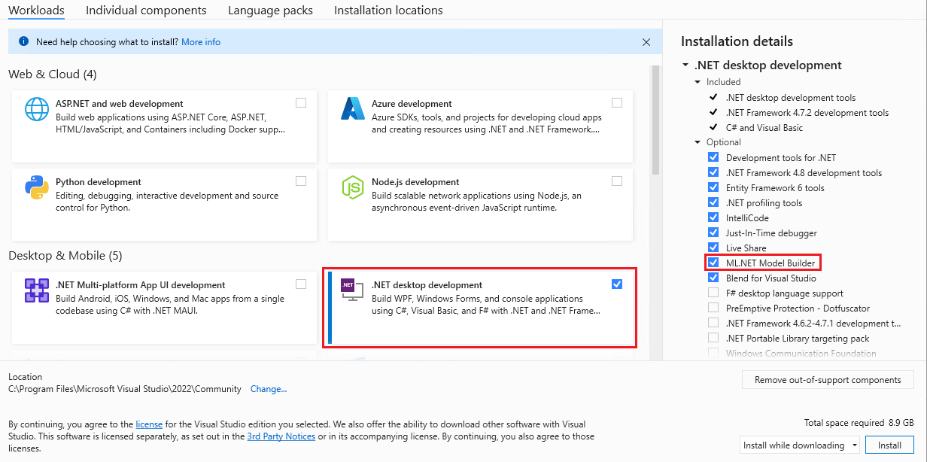
Sample ML.NET Builder
Step 0: Make sure that the “ML.NET Model Builder” is installed

Slide 19
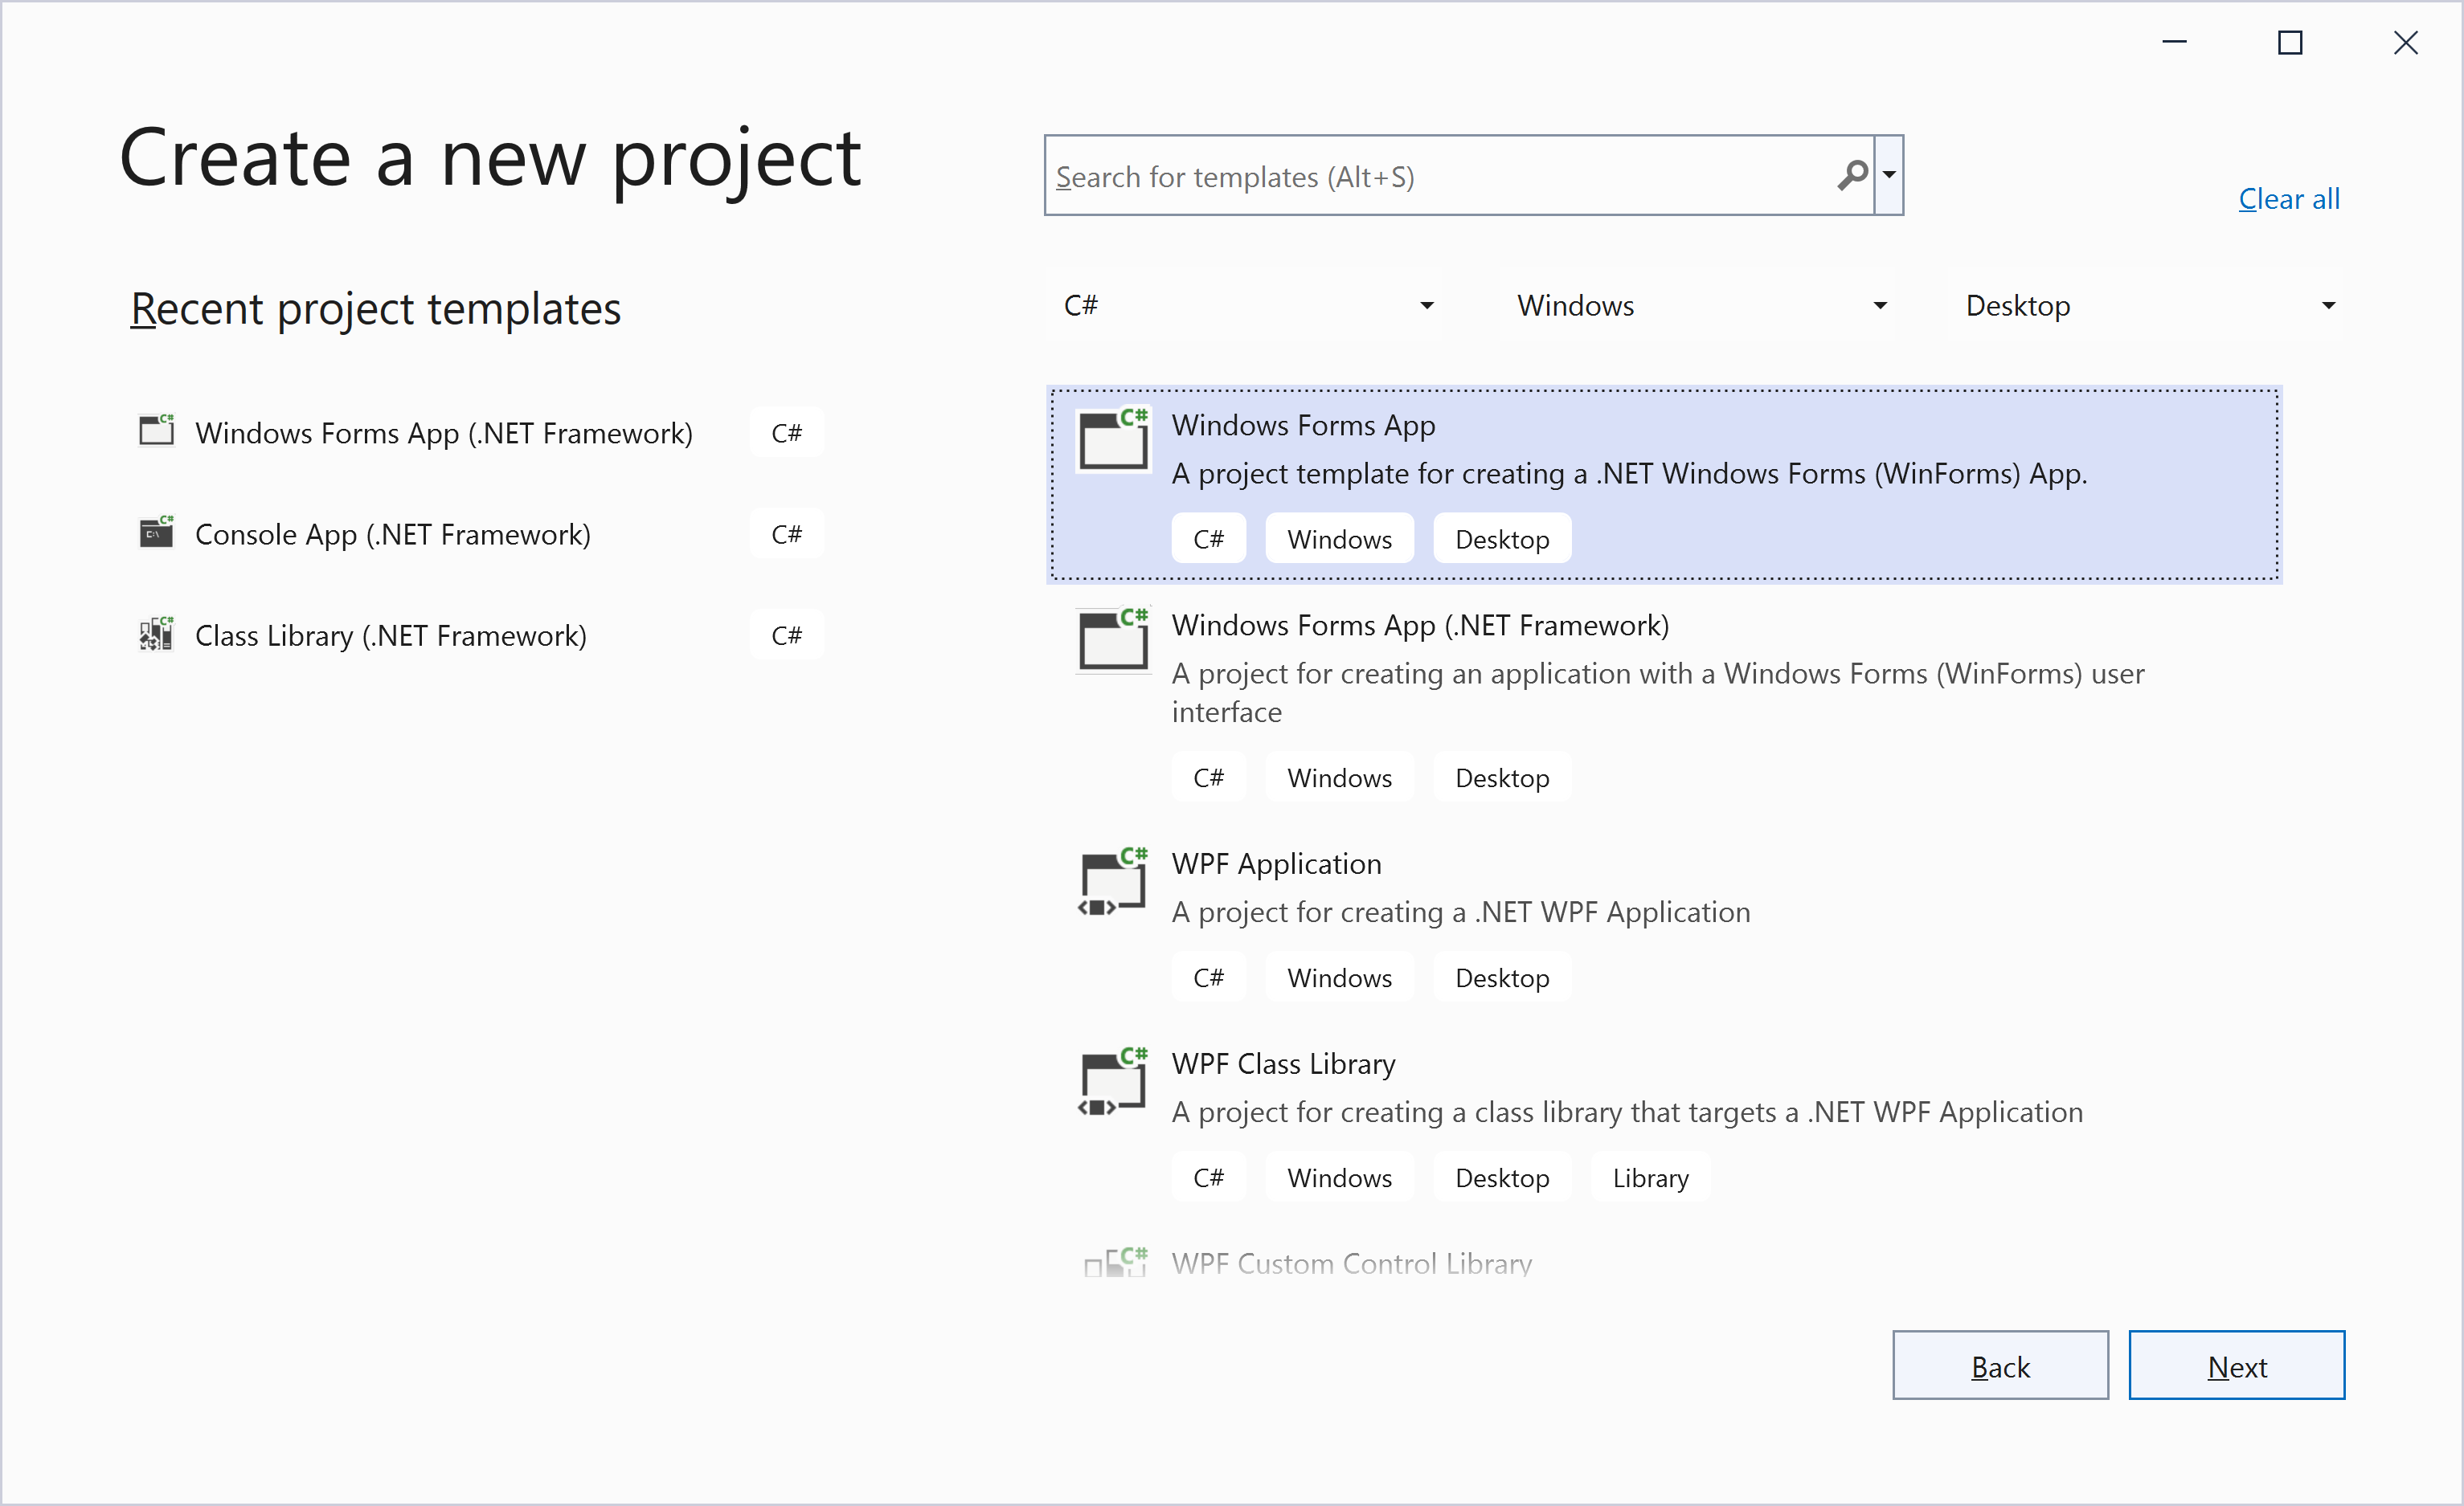
Sample ML.NET Builder
Step 1: Create “SentimentApp” with Windows Forms App

Slide 20
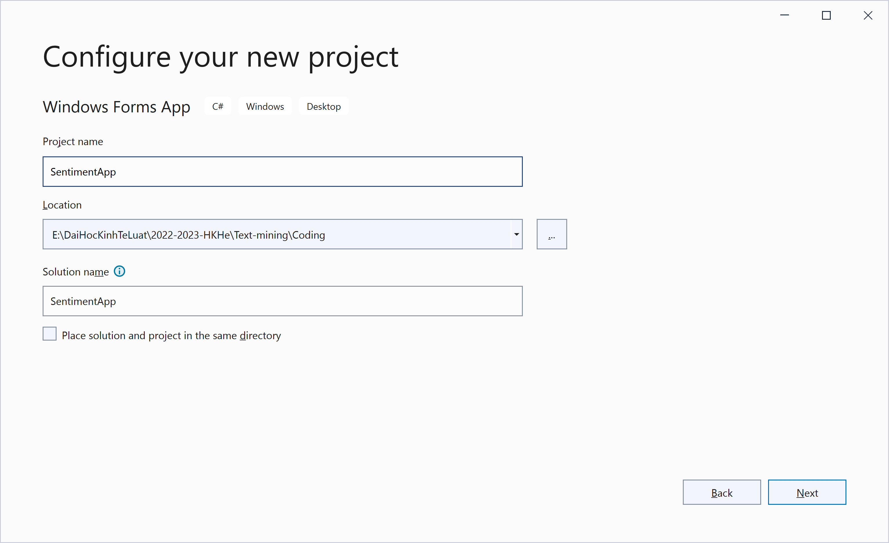
Sample ML.NET Builder
Step 1: Create “SentimentApp” with Windows Forms App
1
2

Slide 21
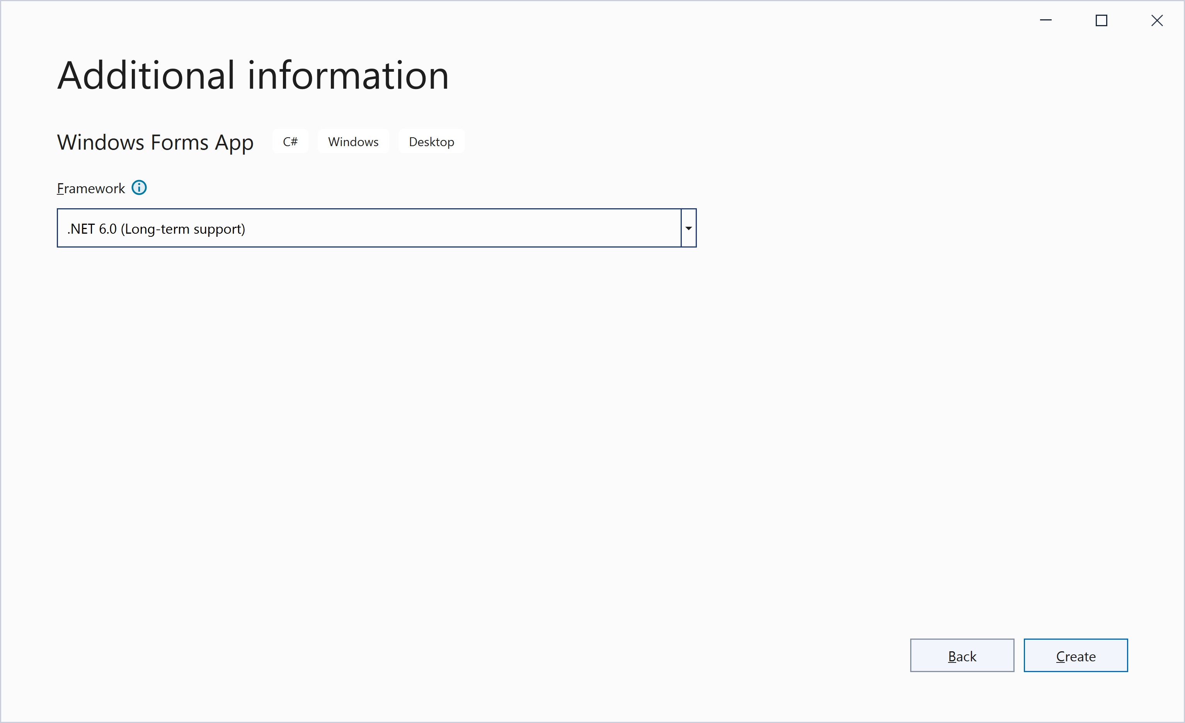
Sample ML.NET Builder
Step 1: Create “SentimentApp” with Windows Forms App

Slide 22
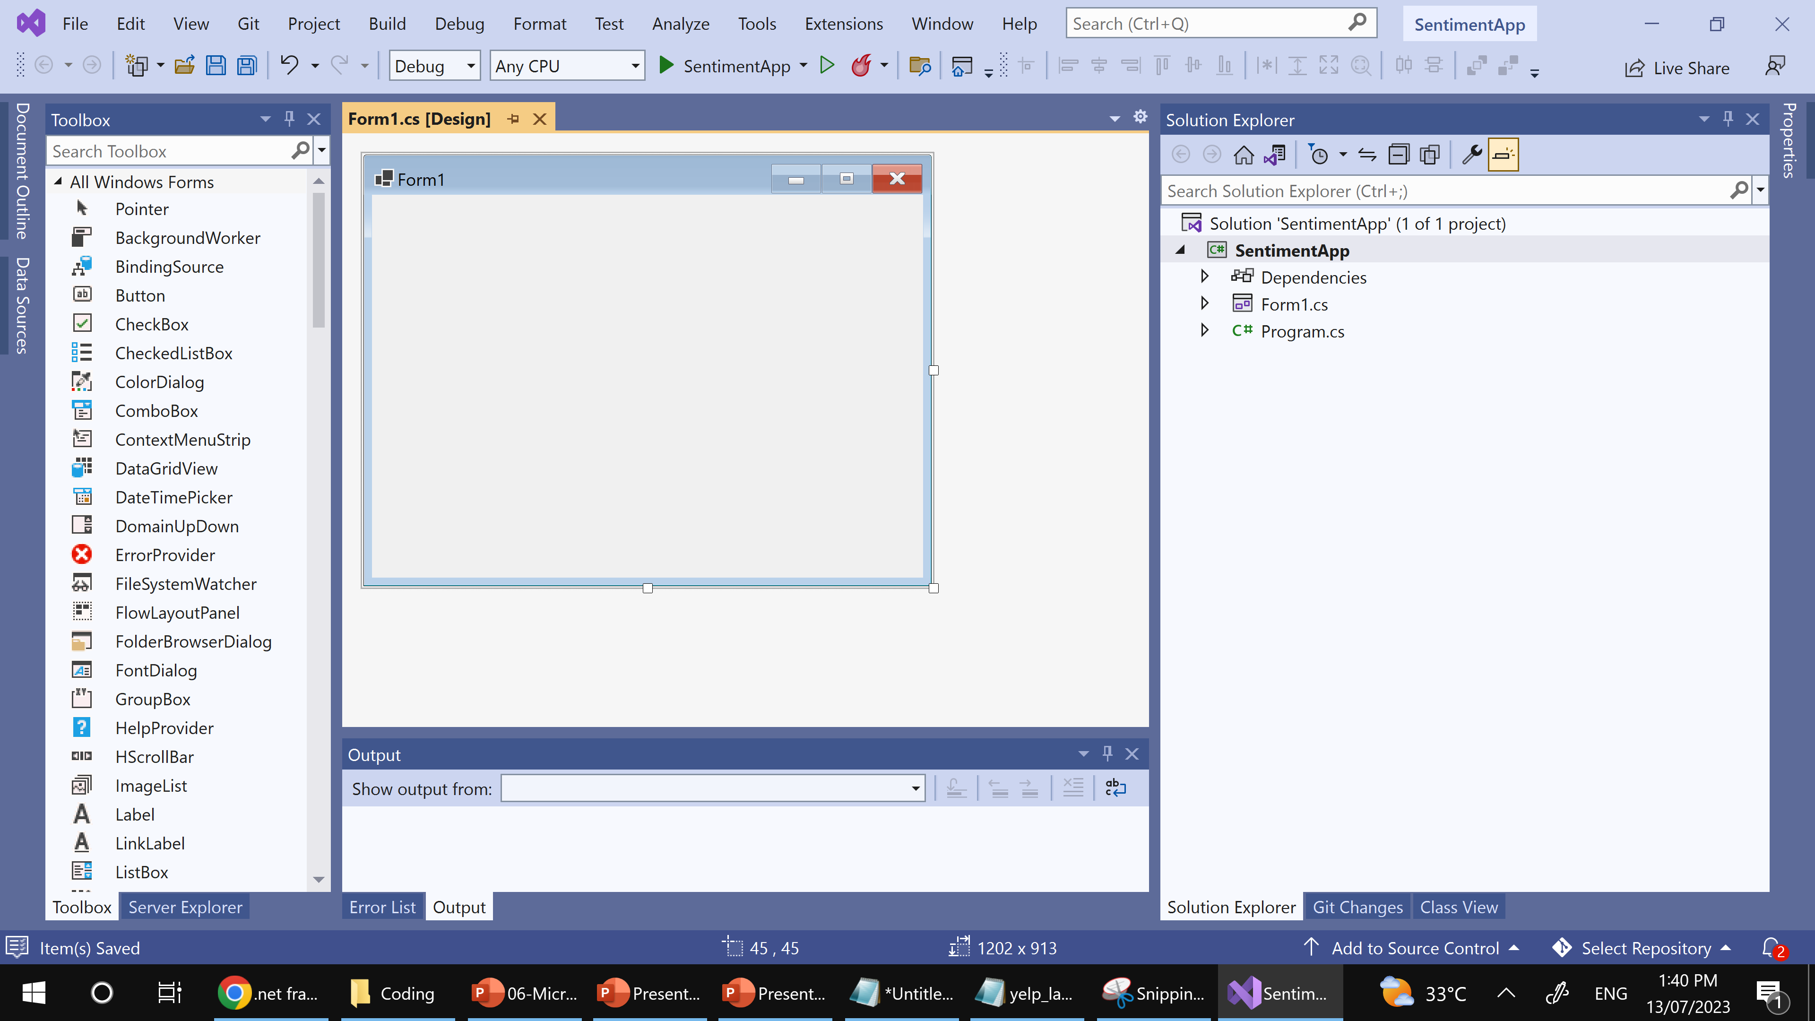
Sample ML.NET Builder
The first Screen for Sentiment Application

Slide 23
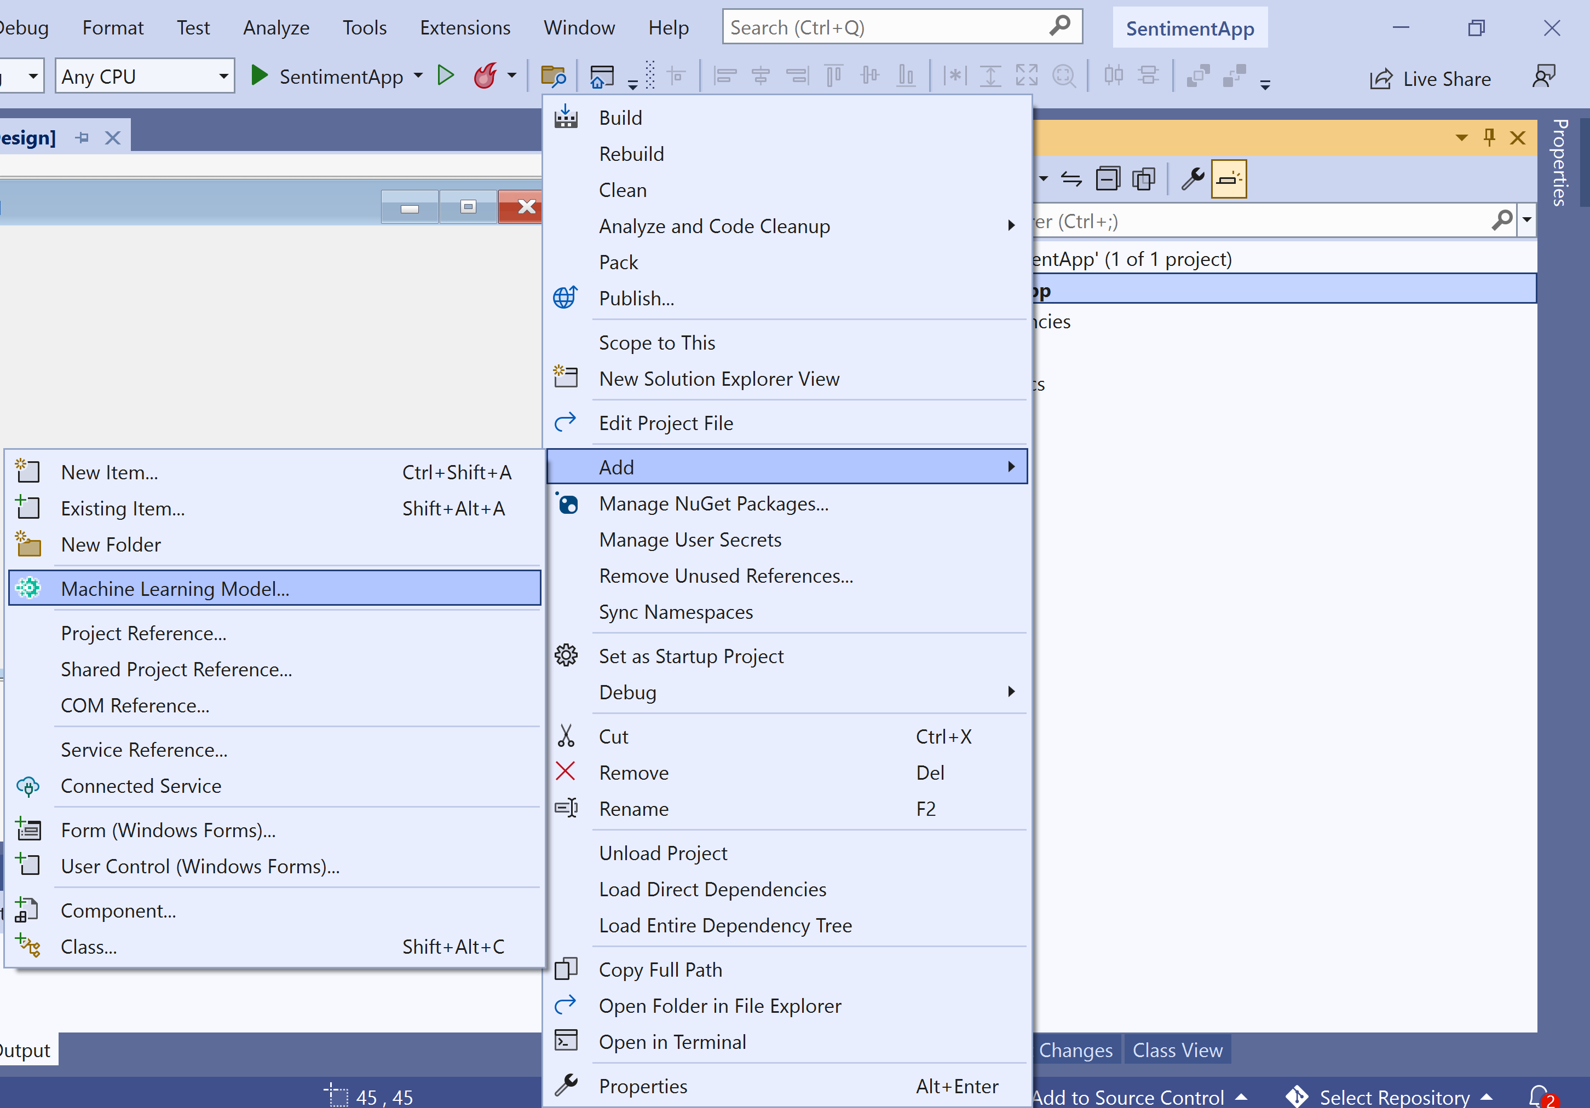
Sample ML.NET Builder
Step 2: Create machine Learning Model
-Right click on Project
-Choose Add
-Then Choose :
Machine Learning Model…

Slide 24
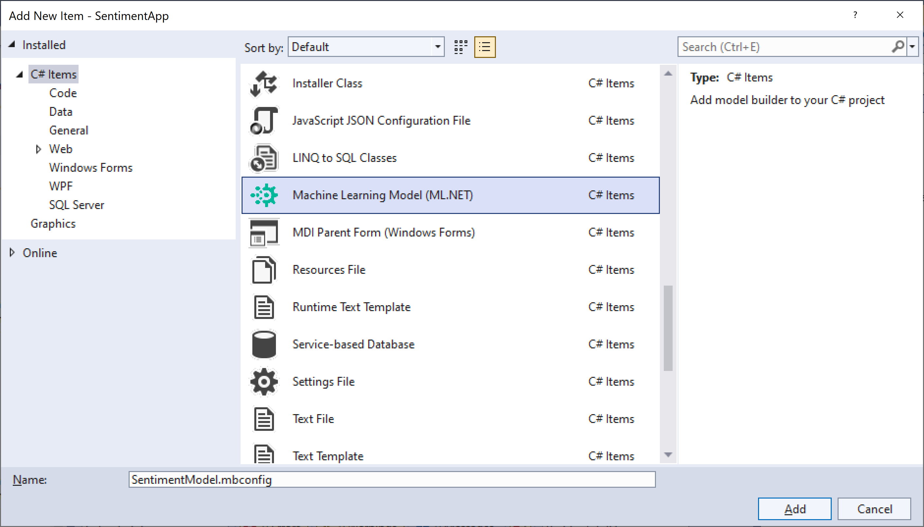
Sample ML.NET Builder
Enter “SentimentModel.mbconfig” then click Add button
1
2
3

Slide 25
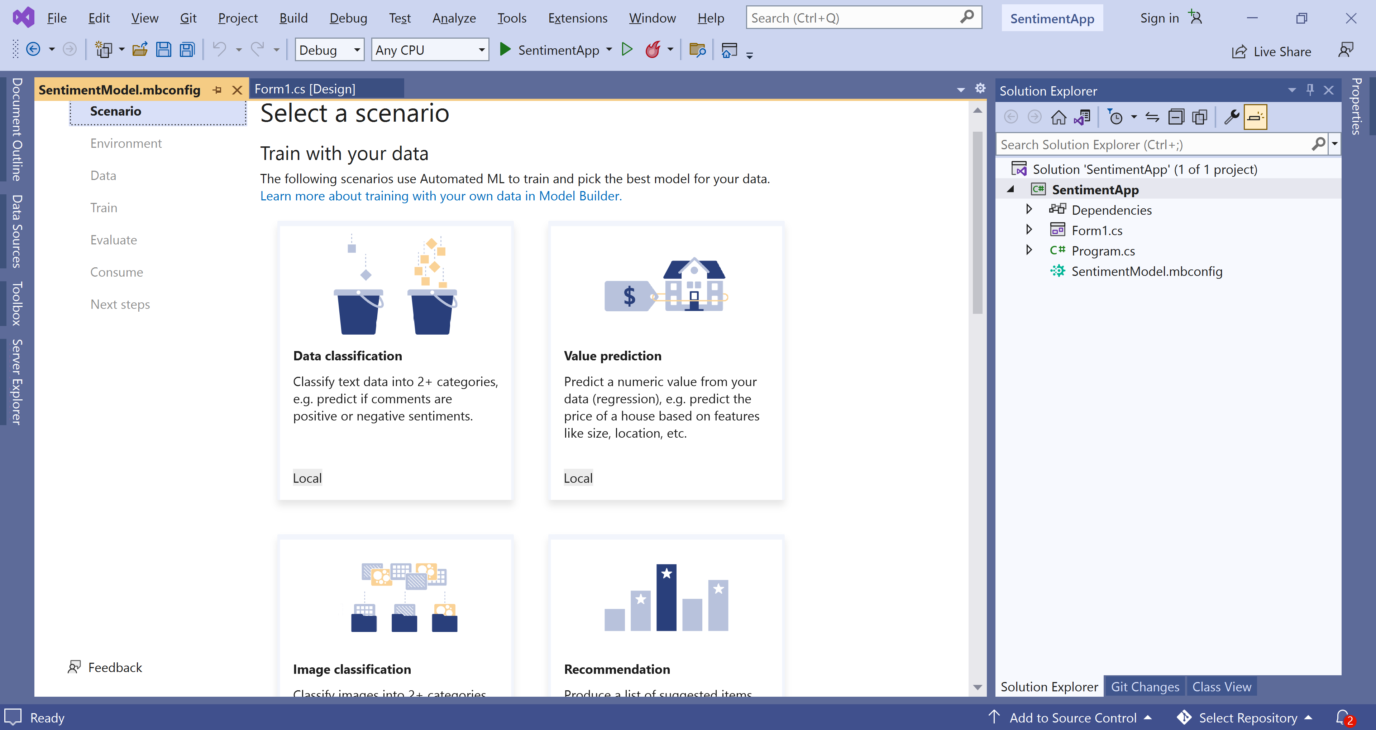
Sample ML.NET Builder
Step 3: Pick a scenario
To generate your model, you first need to select your machine learning scenario. Model Builder supports several scenarios:

Slide 26
Sample ML.NET Builder
Step 3: Pick a scenario
In this case, you'll predict sentiment based on the content (text) of customer reviews.
In the Model Builder Scenario screen, select the Data classification scenario, since you're predicting which category a comment falls into (positive or negative).
After selecting the Data classification scenario, you must choose your training environment. While some scenarios support training in Azure, Classification currently only supports local training, so keep the Local environment selected and move on to the Data step.

Slide 27
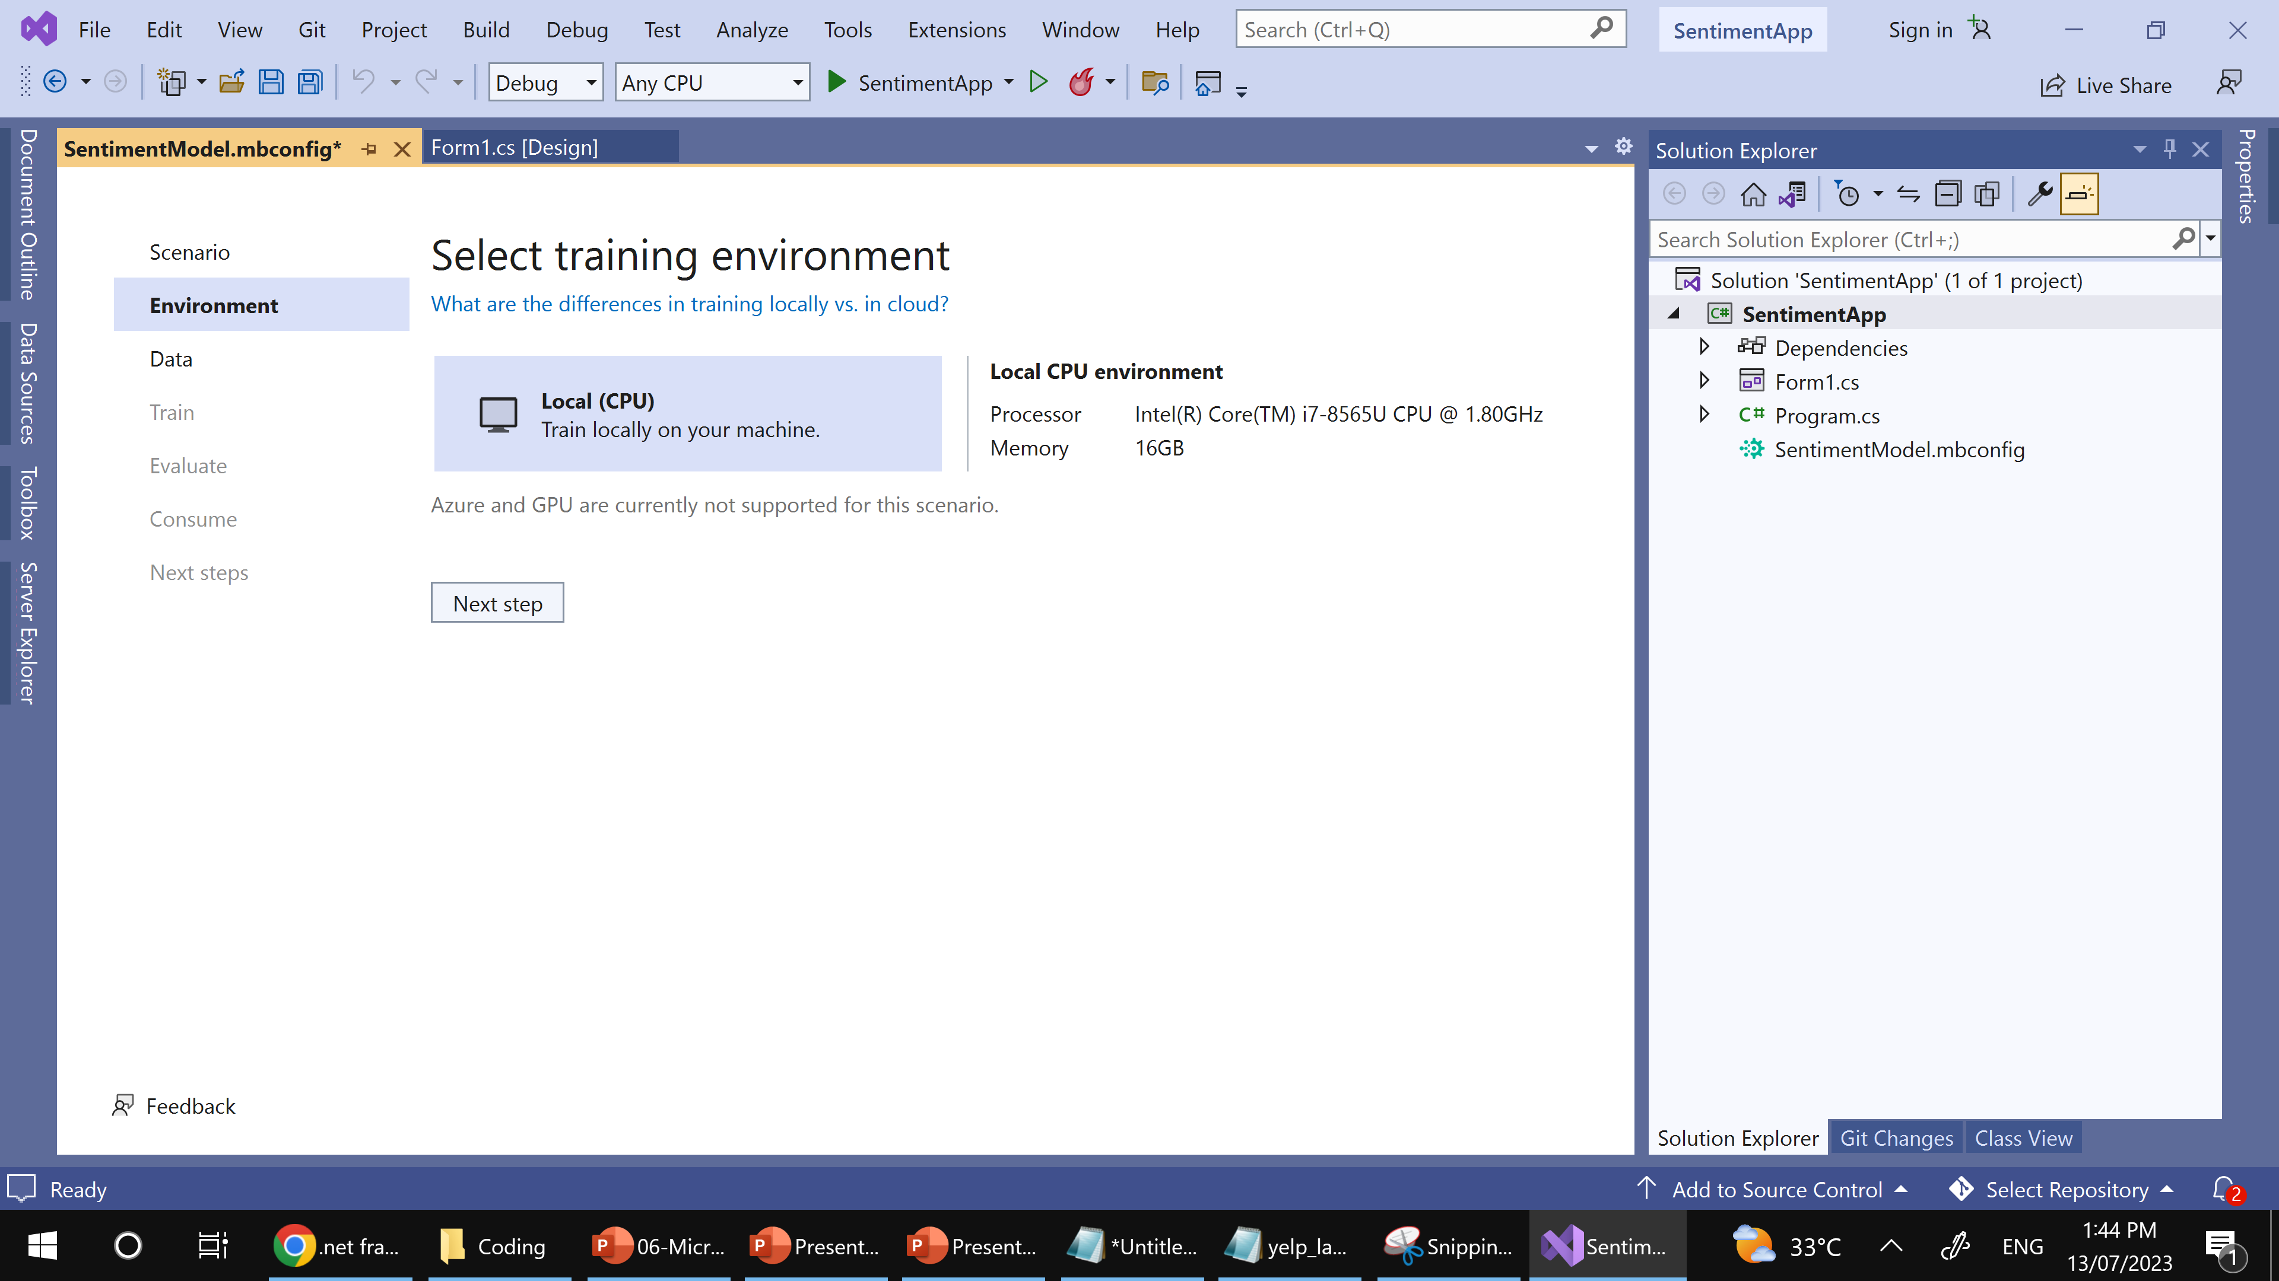
Sample ML.NET Builder
Step 4: Select training environment

Slide 28
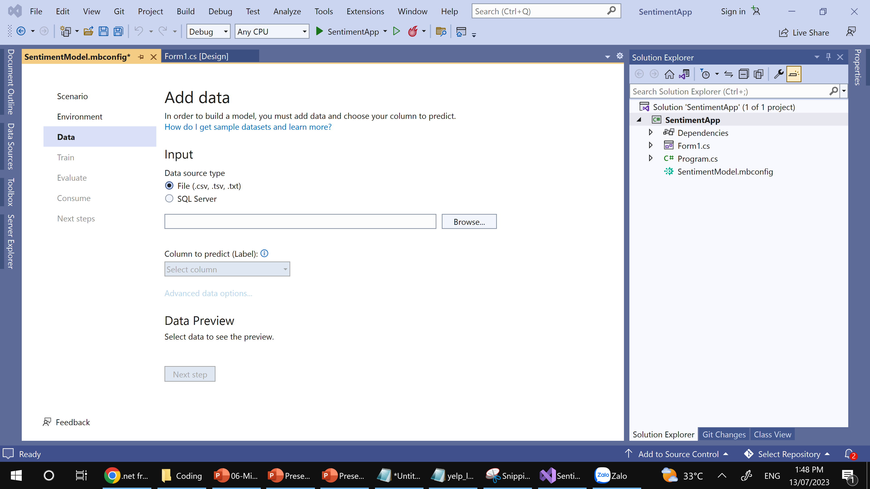
Sample ML.NET Builder
Step 5: Prepare and put Data
-CSV file
-SQL Server

Slide 29
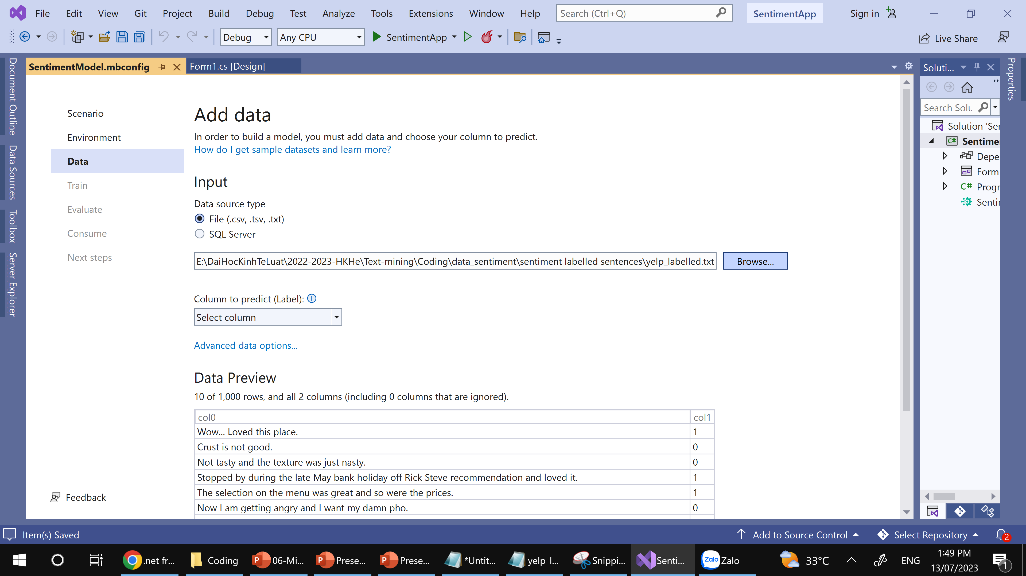
Sample ML.NET Builder
Step 5: Prepare and put Data
Brower to “yelp_labelled.txt” file

Slide 30
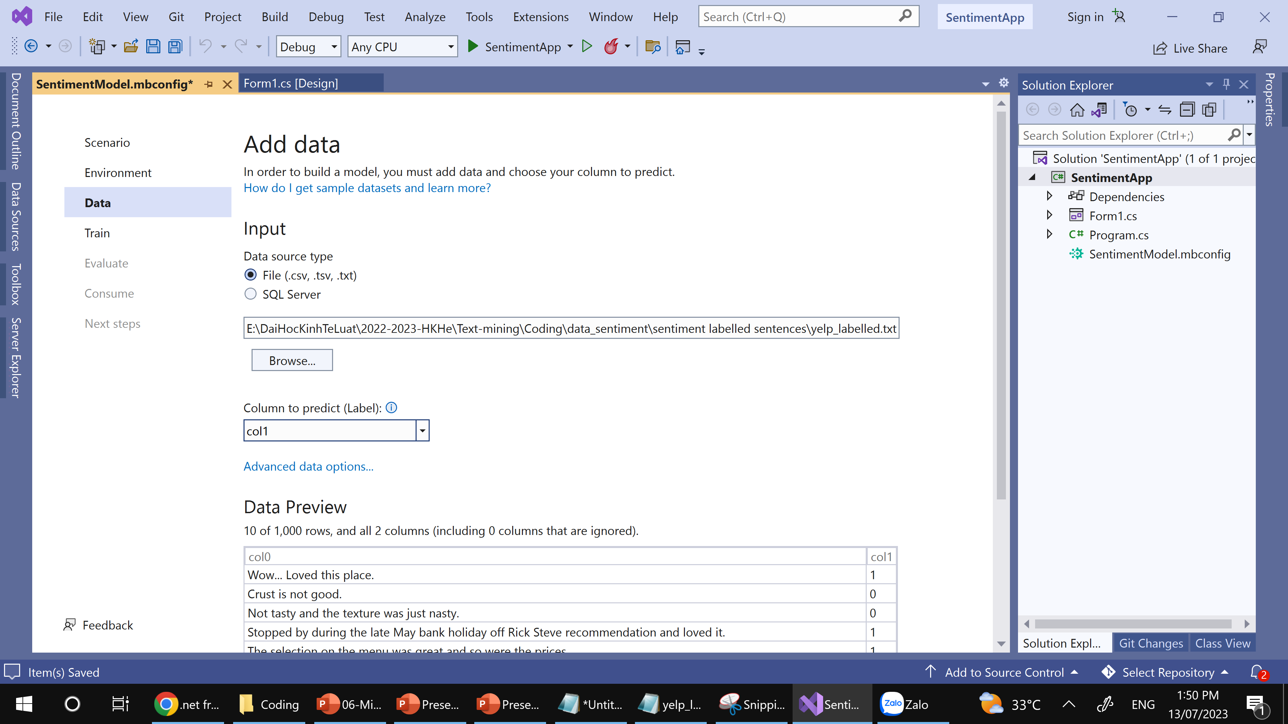
Sample ML.NET Builder
Step 6: Prepare and put Data➔choose predict column

Slide 31
Sample ML.NET Builder
Step 7: Train model
Now, you'll train your model with the “yelp_labelled.txt” dataset.
Model Builder evaluates many models with varying algorithms and settings based on the amount of training time given to build the best performing model.
Change the Time to train, which is the amount of time you'd like Model Builder to explore various models, to 60 seconds (you can try increasing this number if no models are found after training) . Note that for larger datasets, the training time will be longer. Model Builder automatically adjusts the training time based on the dataset size.
Select Start training to start the training process. Once training starts, you can see the time remaining.

Slide 32
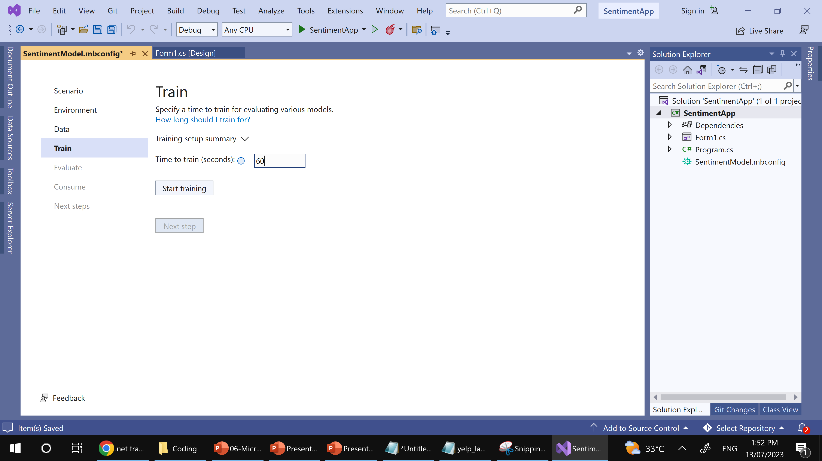
Sample ML.NET Builder
Step 7: Train model
1
2

Slide 33
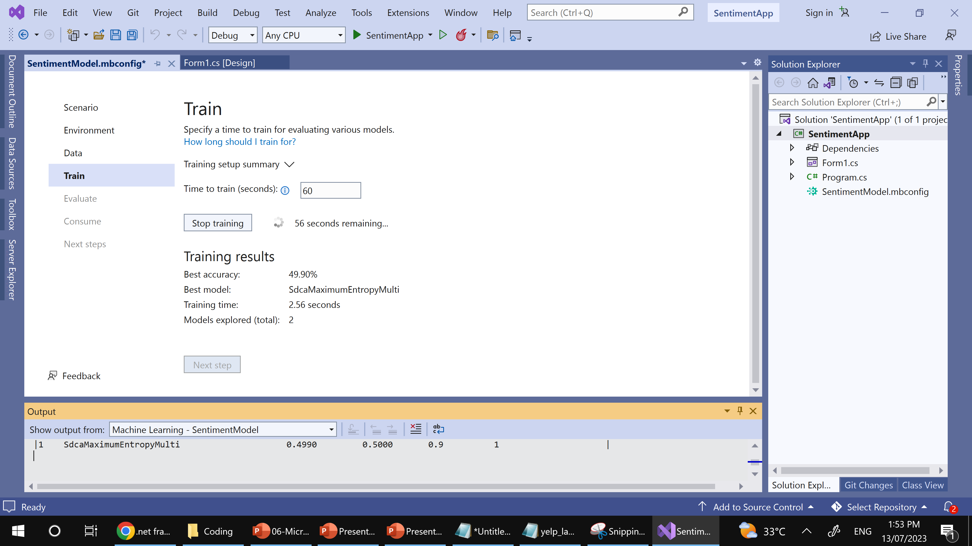
Sample ML.NET Builder
Step 7: Train model➔Training results

Slide 34
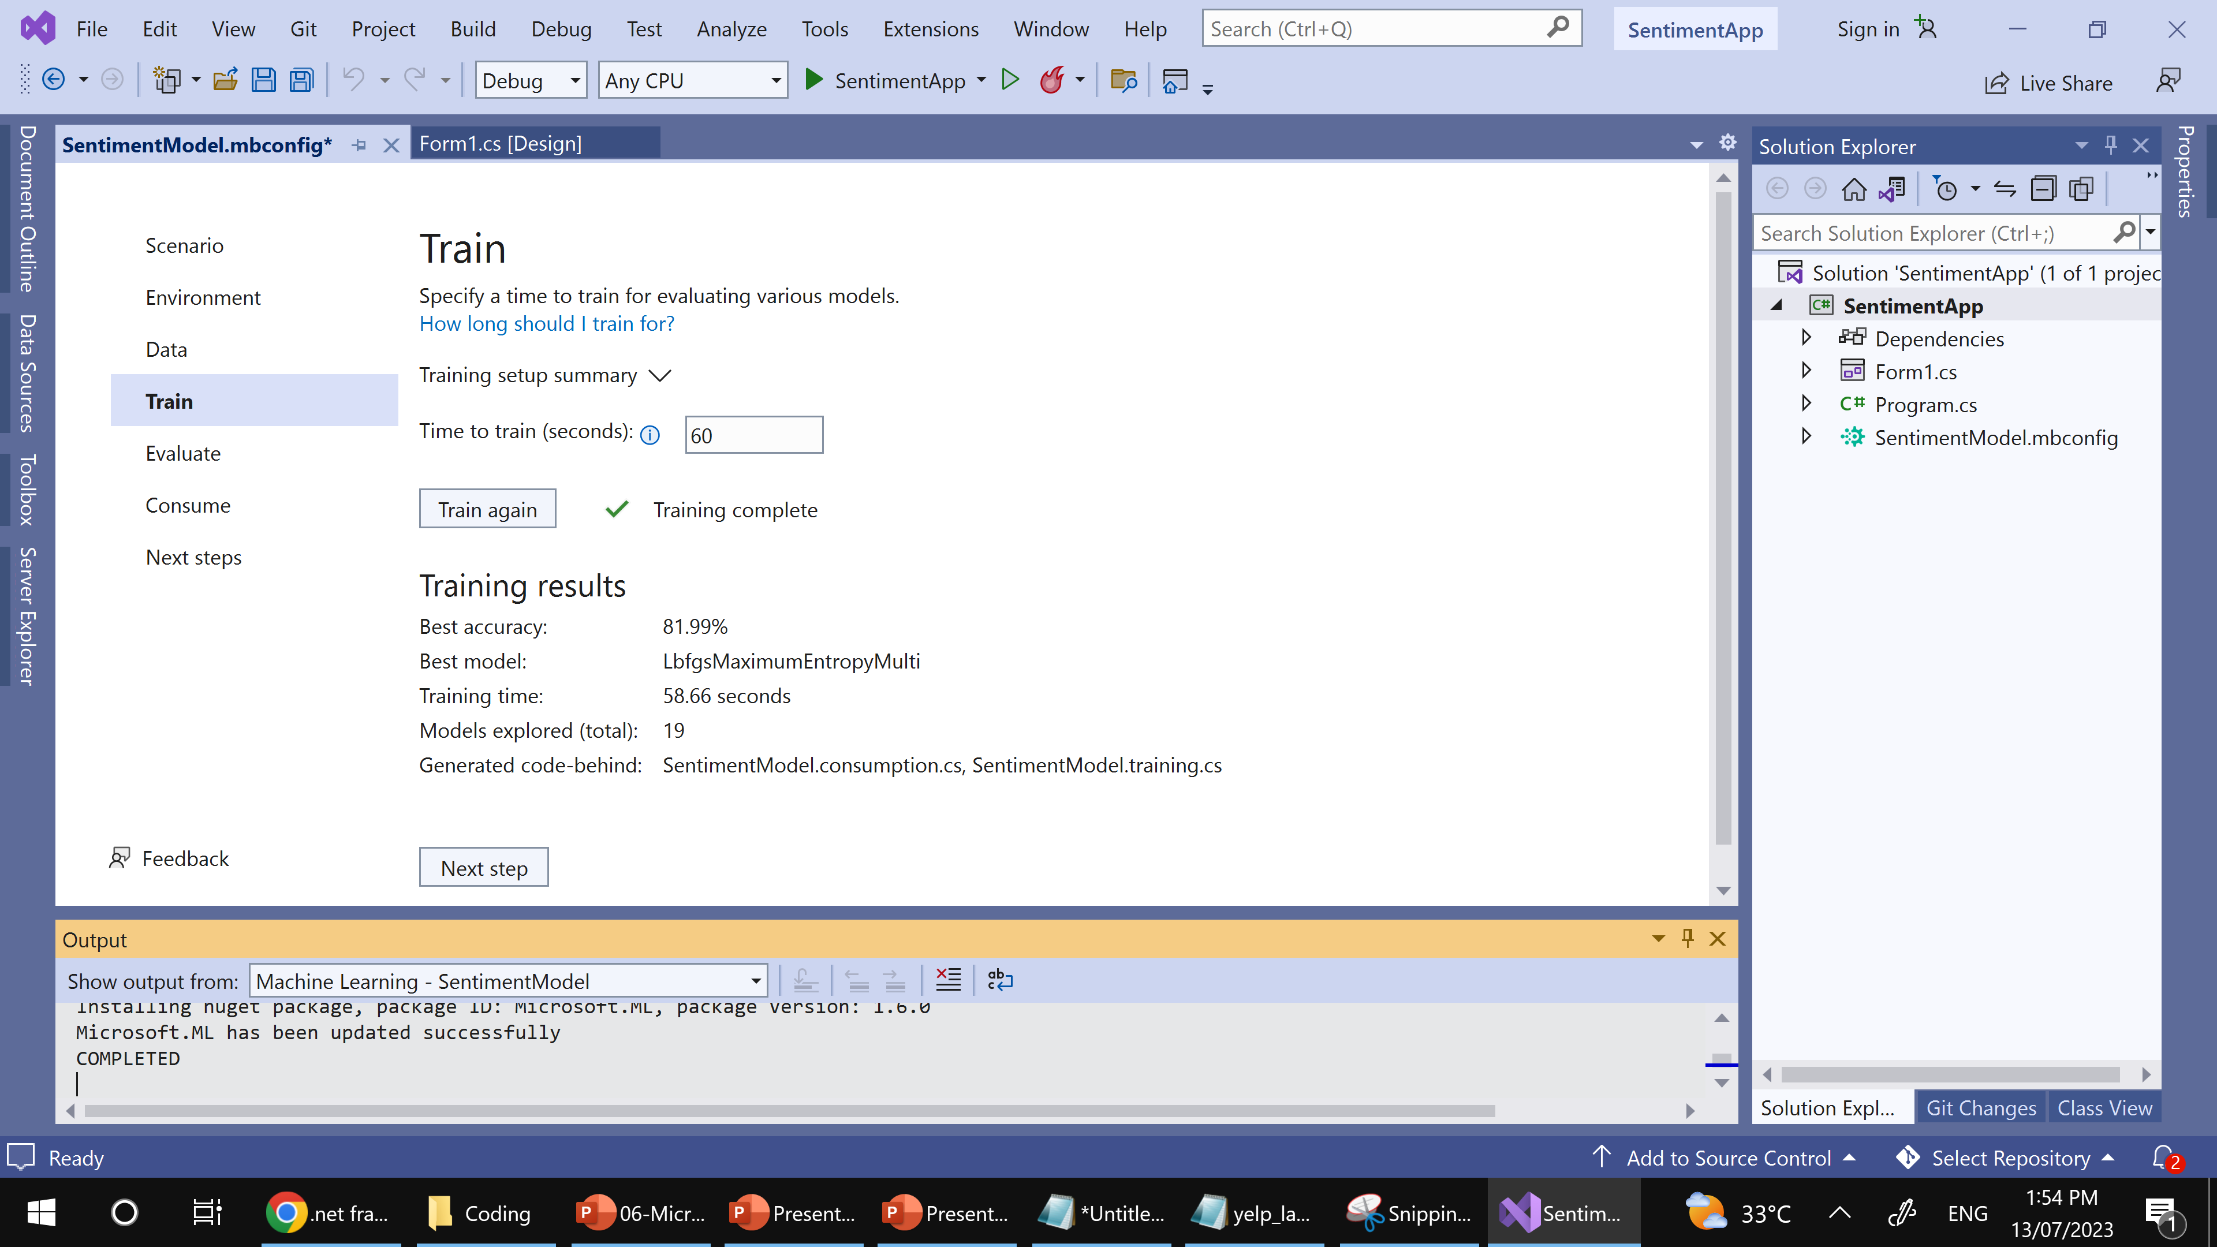
Sample ML.NET Builder
Step 7: Train model➔Training results

Slide 35
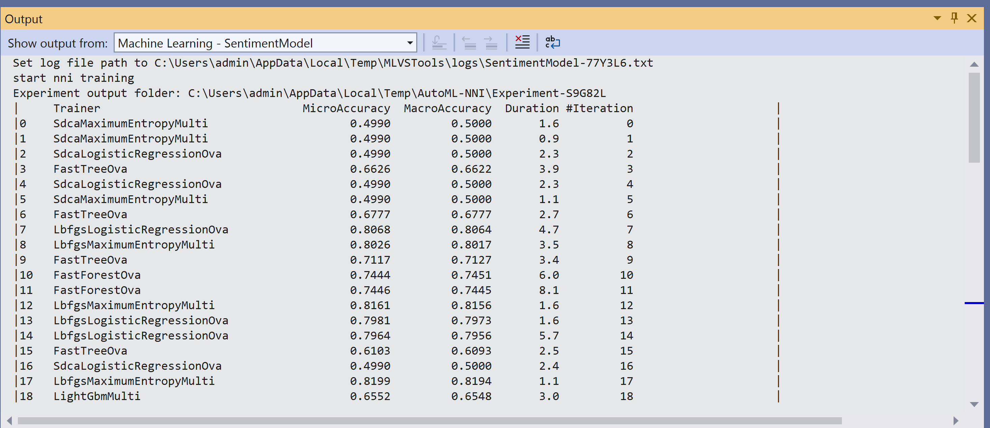
Sample ML.NET Builder
Step 7: Train model➔Training results

Slide 36
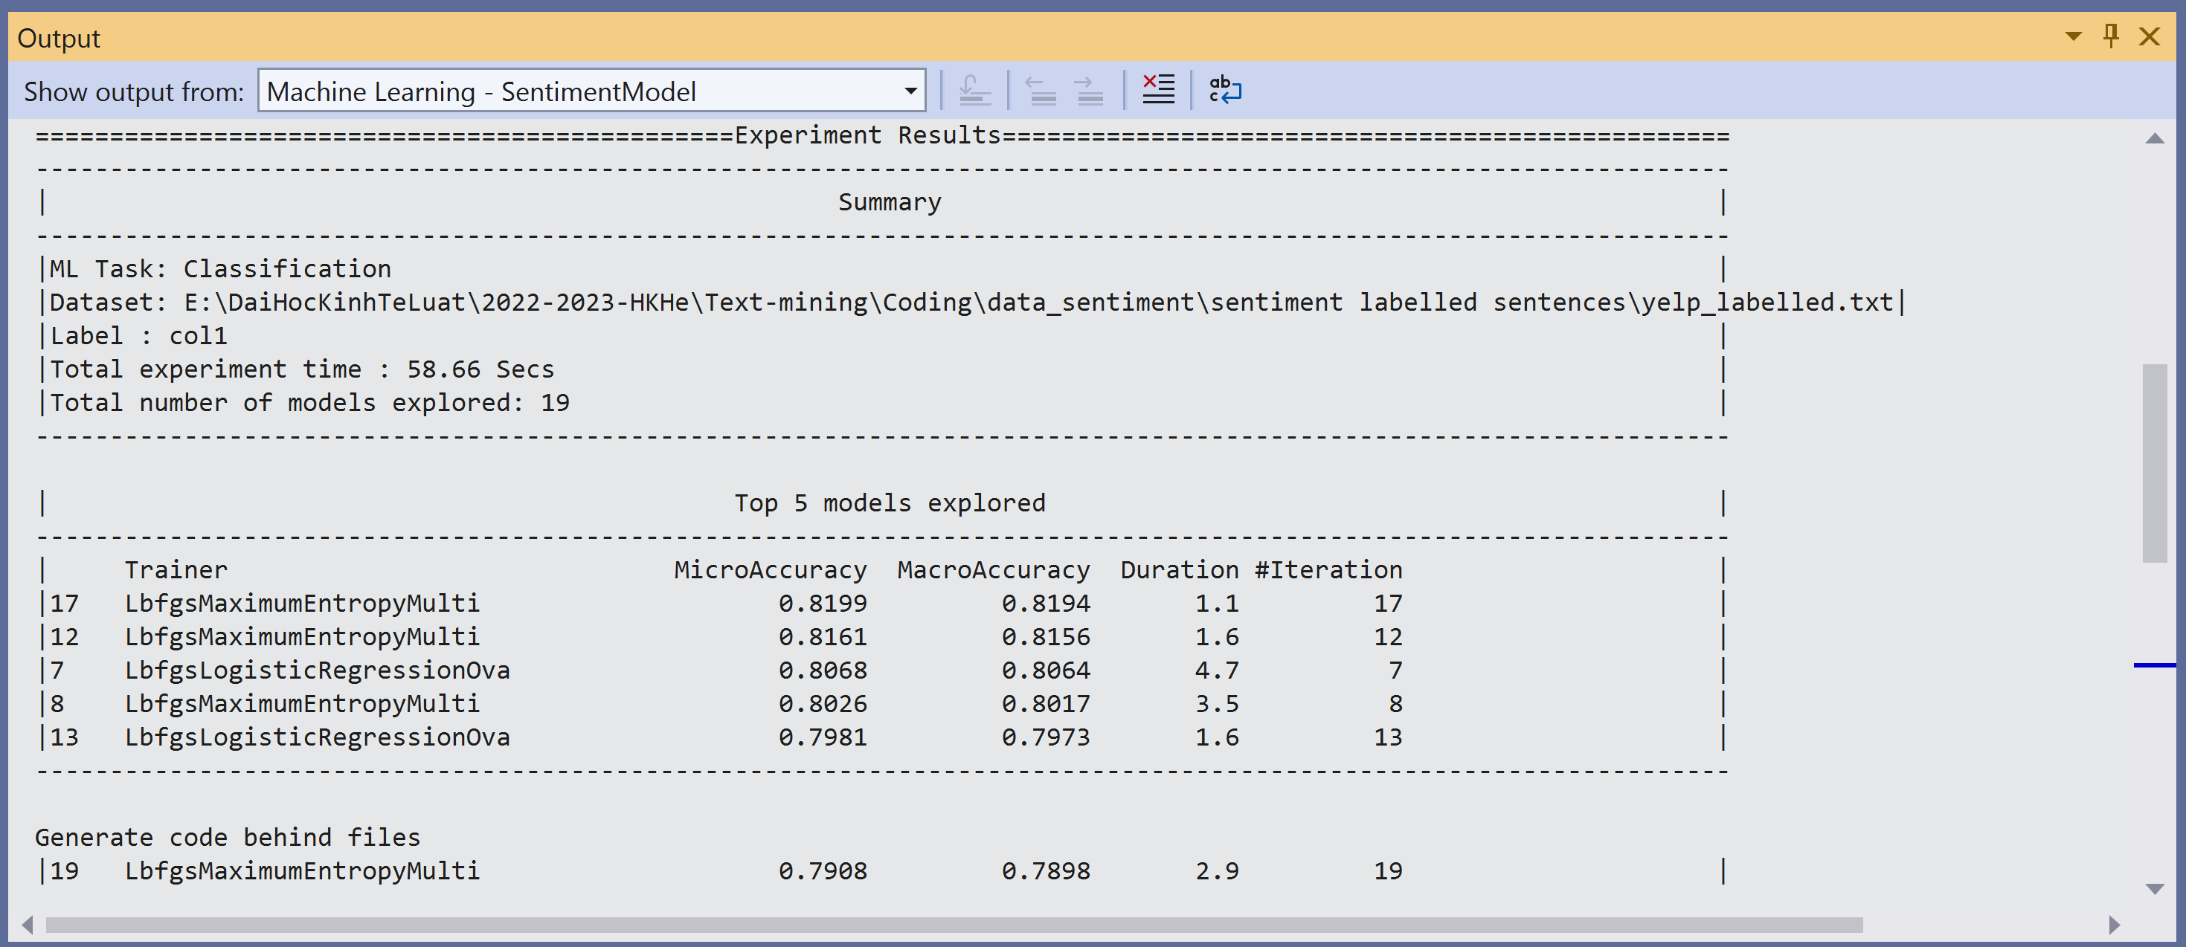
Sample ML.NET Builder
Step 7: Train model➔Training results

Slide 37
Sample ML.NET Builder
Step 8: Evaluate model
The Evaluate step shows you the best-performing algorithm and the best accuracy and lets you try out the model in the UI.
You can make predictions on sample input in the Try your model section. The textbox is pre-filled with the first line of data from your dataset, but you can change the input and select the Predict button to try out different sentiment predictions.
In this case, 0 means negative sentiment and 1 means positive sentiment.

Slide 38
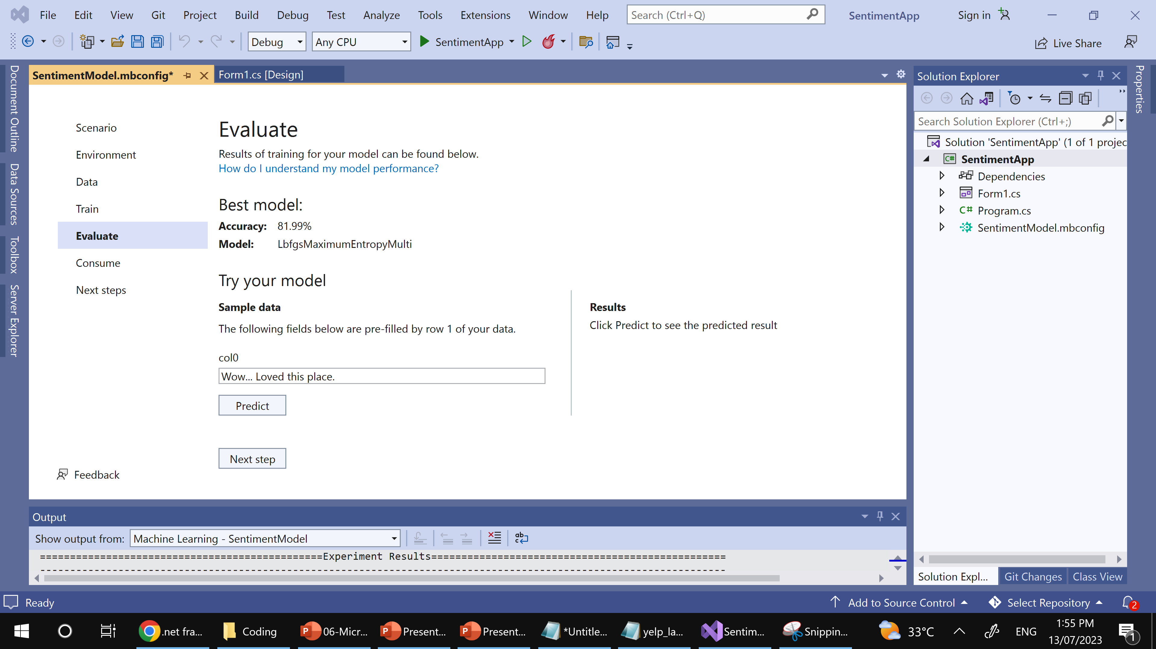
Sample ML.NET Builder
Step 8: Evaluate model

Slide 39
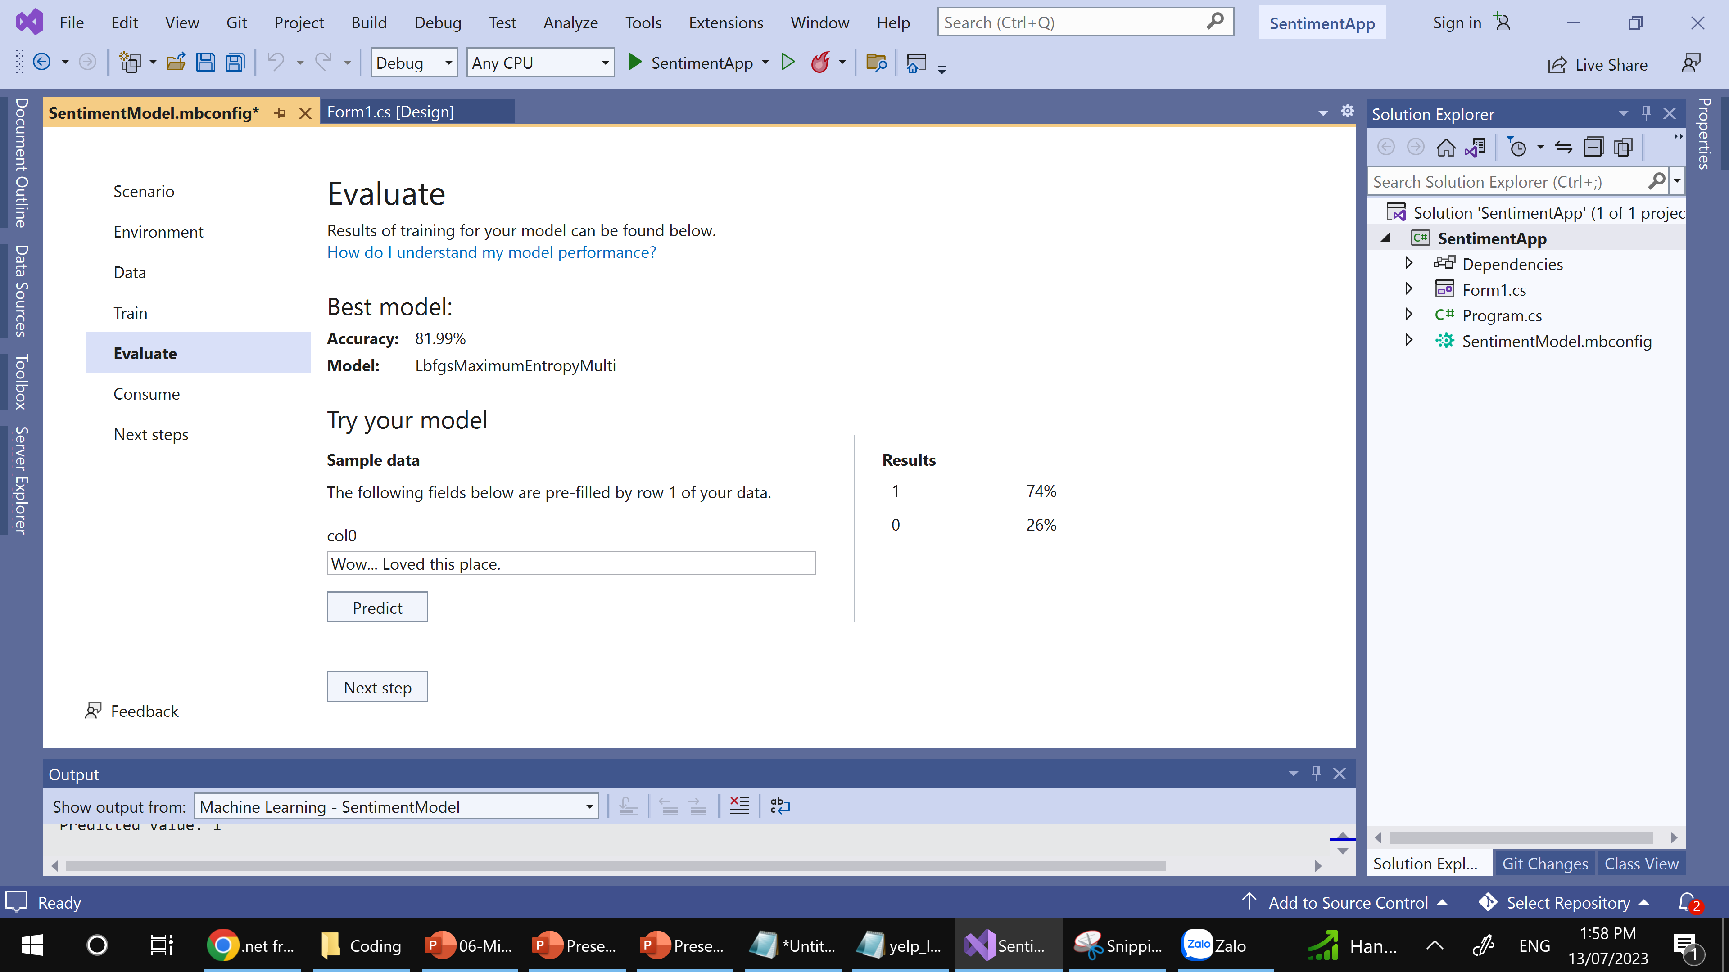
Sample ML.NET Builder
Step 8: Evaluate model

Slide 40
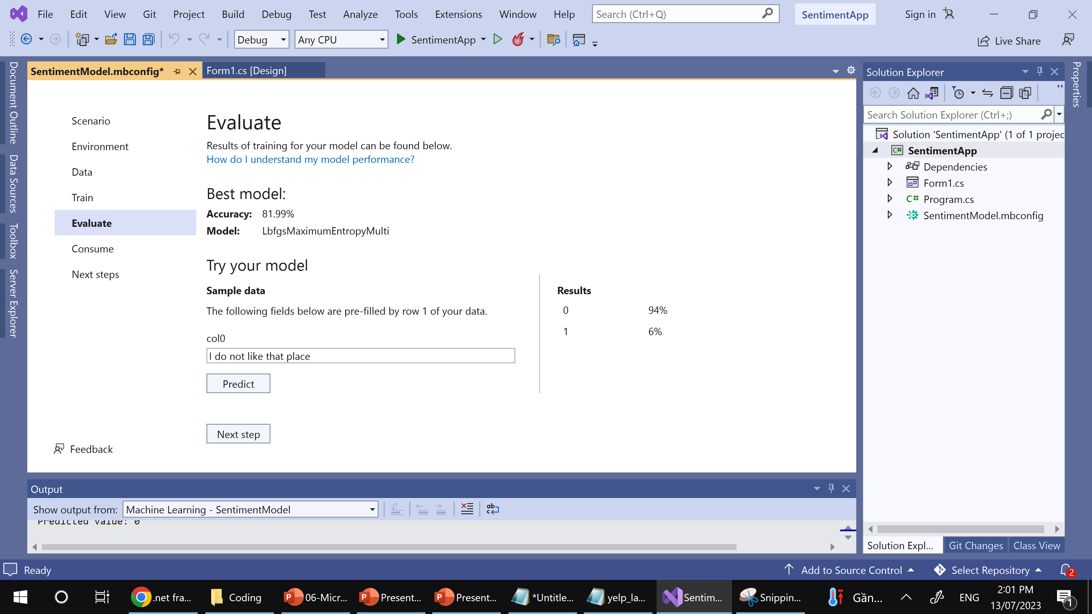
Sample ML.NET Builder
Step 8: Evaluate model

Slide 41
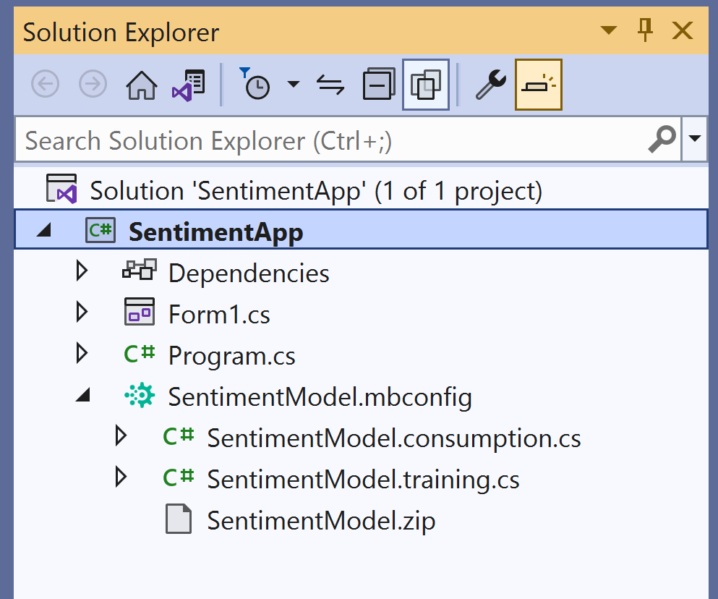
Sample ML.NET Builder
Step 9: Take a look Generate code
After training is completed, three files are automatically added as code-behind to the SentimentModel.mbconfig:
SentimentModel.zip: This file is the trained ML.NET model, which is a serialized zip file.
SentimentModel.consumption.cs: This file contains the model input and output classes and a Predict method that can be used for model consumption.
SentimentModel.training.cs: This file contains the training pipeline (data transforms, algorithm, and algorithm parameters) used to train the final model.

Slide 42
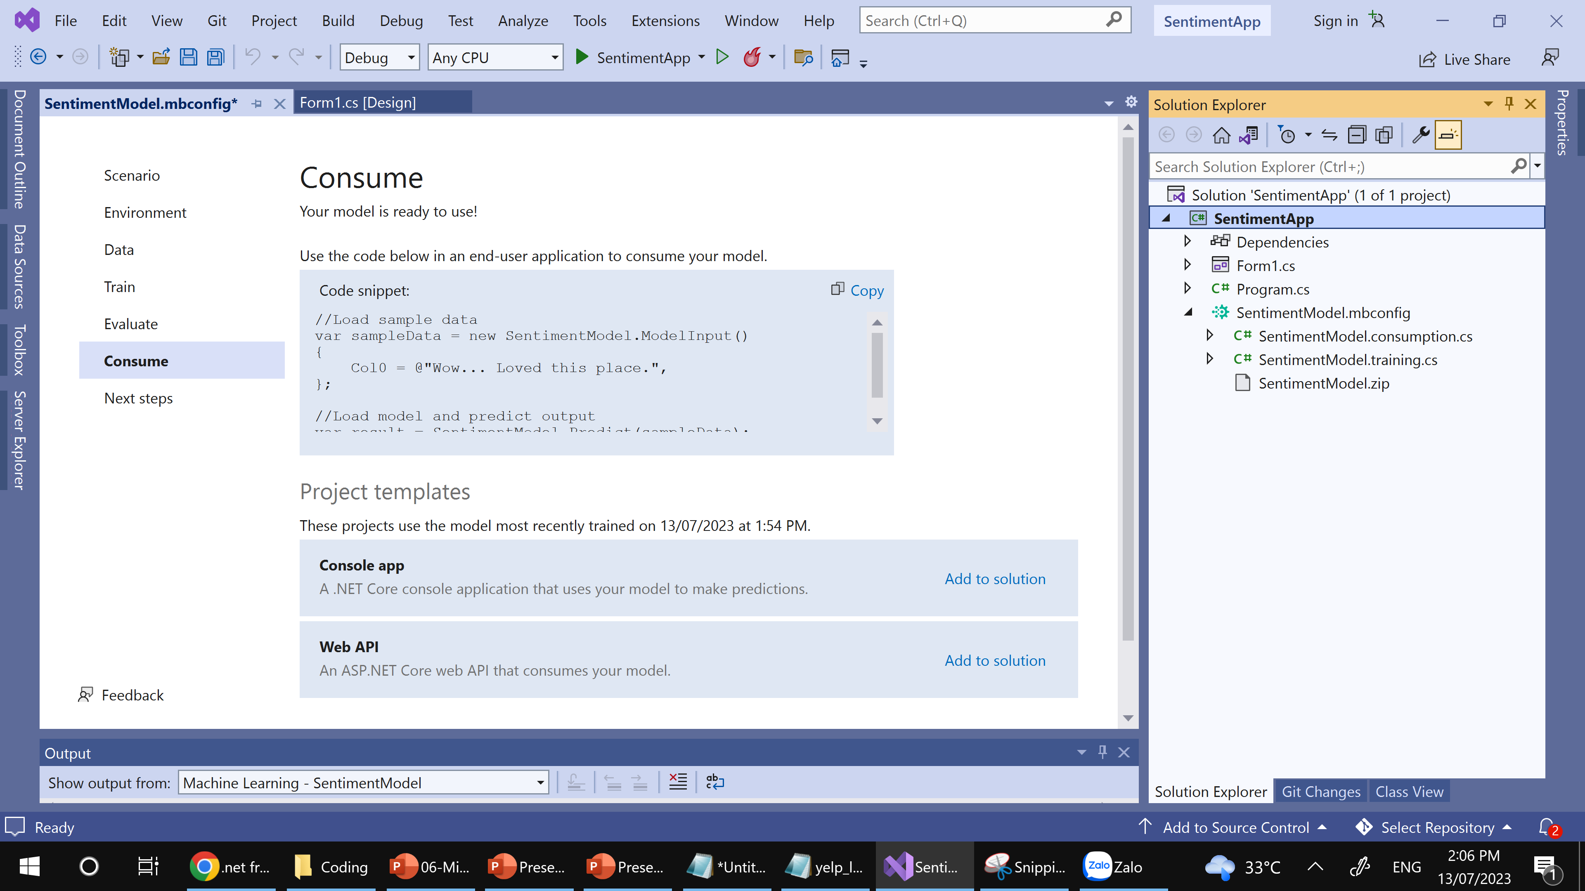
Sample ML.NET Builder
Step 10: Consume Model

Slide 43
Sample ML.NET Builder
Step 10: Consume Model
In the Consume step in Model Builder, a code snippet is provided which creates sample input for the model and uses the model to make a prediction on that input.
Model Builder also offers Project templates that you can optionally add to your solution. There are two project templates (a console app and a web API), both which consume the trained model.
// Add input data
var sampleData = new SentimentModel.ModelInput()
{
Col0 = "This restaurant was wonderful."
};
// Load model and predict output of sample data
var result = SentimentModel.Predict(sampleData);
// If Prediction is 1, sentiment is "Positive"; otherwise, sentiment is "Negative"
var sentiment = result.PredictedLabel == 1 ? "Positive" : "Negative";
Console.WriteLine($"Text: {sampleData.Col0}\nSentiment: {sentiment}");

Slide 44
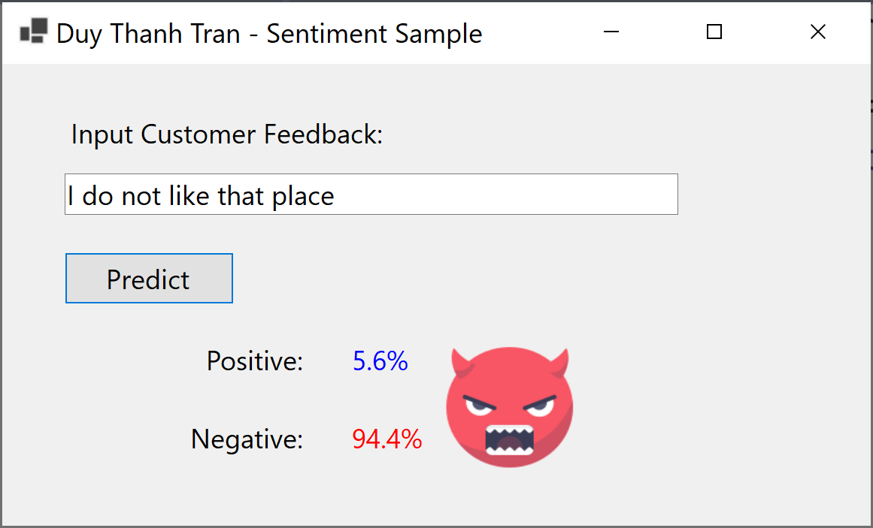
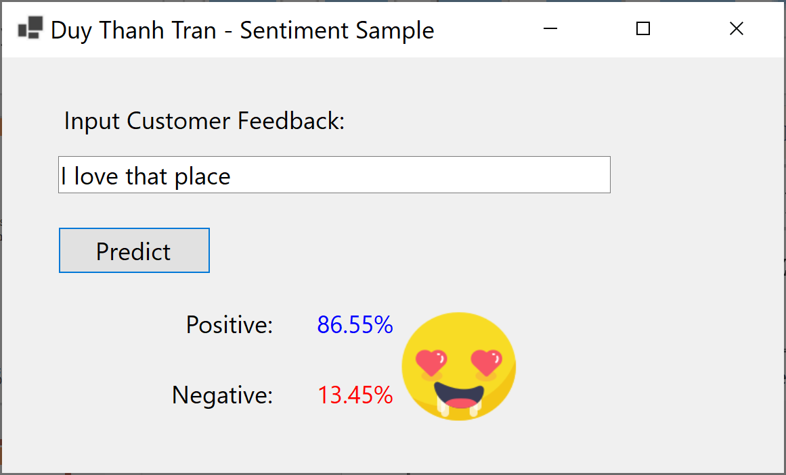
Sample ML.NET Builder
Step 11: Design visualization GUI to use Sentiment model

Slide 45
Sample ML.NET Builder
Step 11: Design visualization GUI to use Sentiment model
private void btnPredict_Click(object sender, EventArgs e) {
//Load sample data
var sampleData = new SentimentModel.ModelInput() {
Col0 = txtInput.Text,
};
//Load model and predict output
var result = SentimentModel.Predict(sampleData);
if(result.Prediction == 1) {
picPositive.Visible = true;
picNegative.Visible = false;
}
else {
picPositive.Visible = false;
picNegative.Visible = true;
}
lblPositive.Text =Math.Round( result.Score[0] * 100,2) + "%";
lblNegative.Text= Math.Round(result.Score[1] * 100, 2) + "%";
}

Slide 46
Bài học tiếp theo
7.4. Customize Mô hình máy học

Slide 47
THANK YOU!

